Slide 1
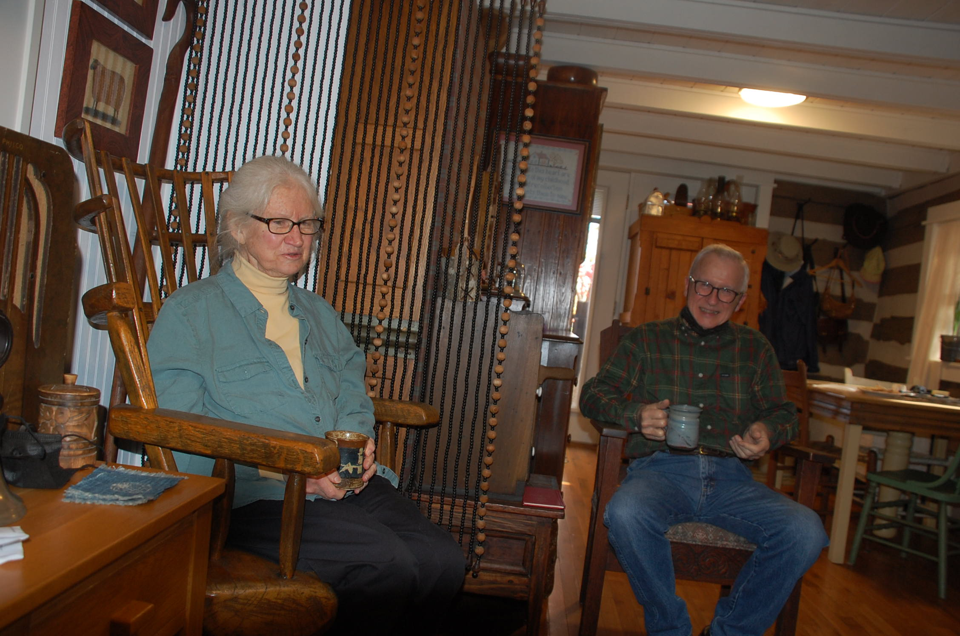
A Visit with the Hensley’s

Slide 2
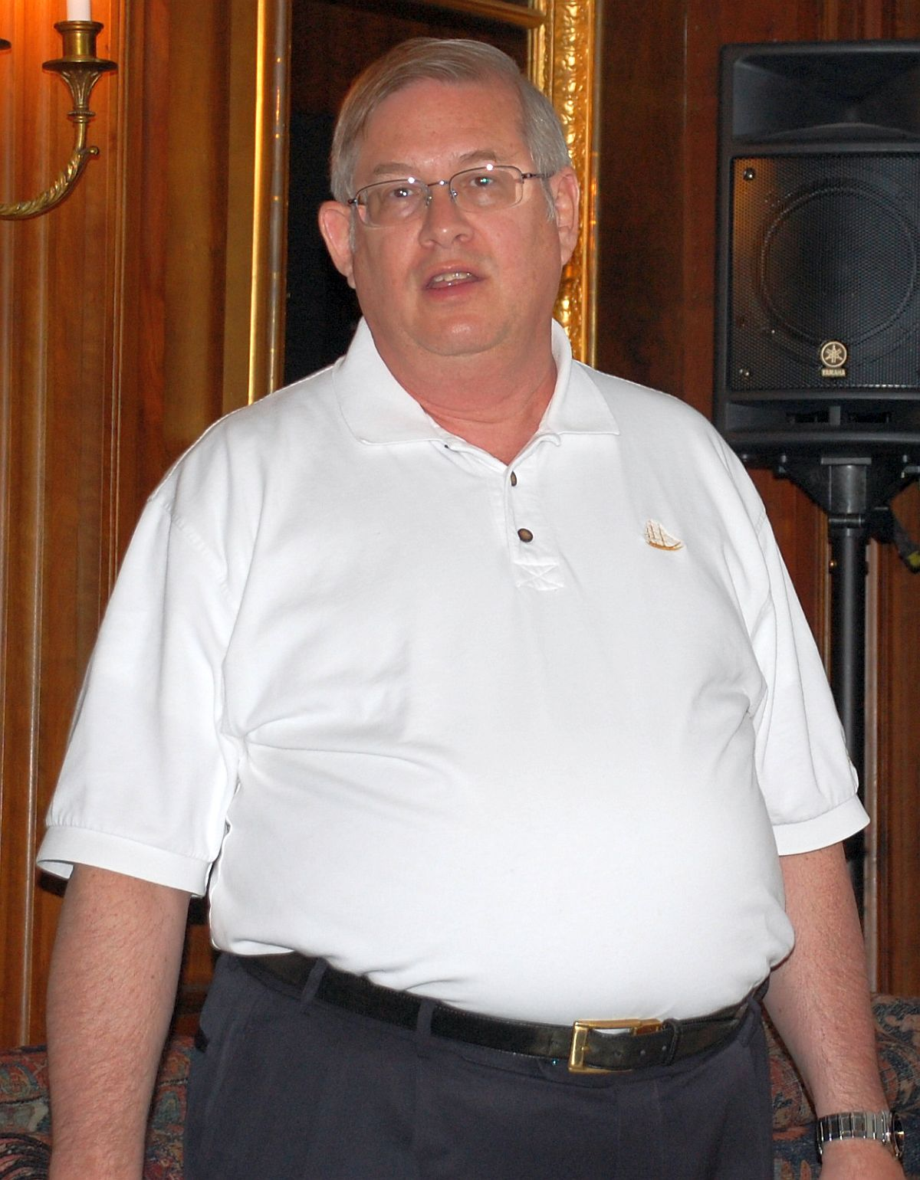
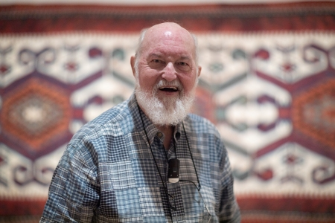
Early in November 2021, my friend Colin England and I (John Howe) went south into Virginia in the comfort of Colin’s BMW.
We were going to visit my friends Janice and Hunter Hensley, who are re-enactors of U.S. life in the 17th and 18th centuries.

Slide 3
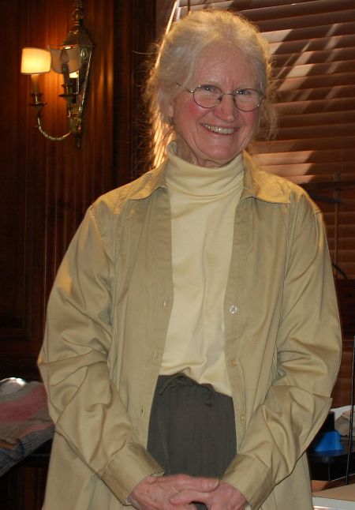
Janice, a dedicated re-enactor, who produces textiles using traditional practices of the American frontier, gave, in 2014, a Rug and Textile Appreciation program here at The Textile Museum in Washington, D. C., on her work.
She then raised Leicester sheep and sheared their wool. She discussed how shorn wool was spun and dyed and woven into blankets, shawls, straps and other utilitarian textiles like those made during the 17th and 18th centuries in frontier America.

Slide 4
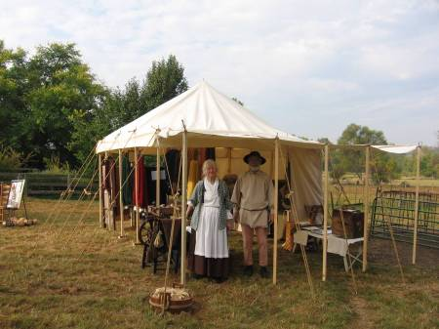
Here, Janice and Hunter, are set up and dressed for a
reenacter event.

Slide 5
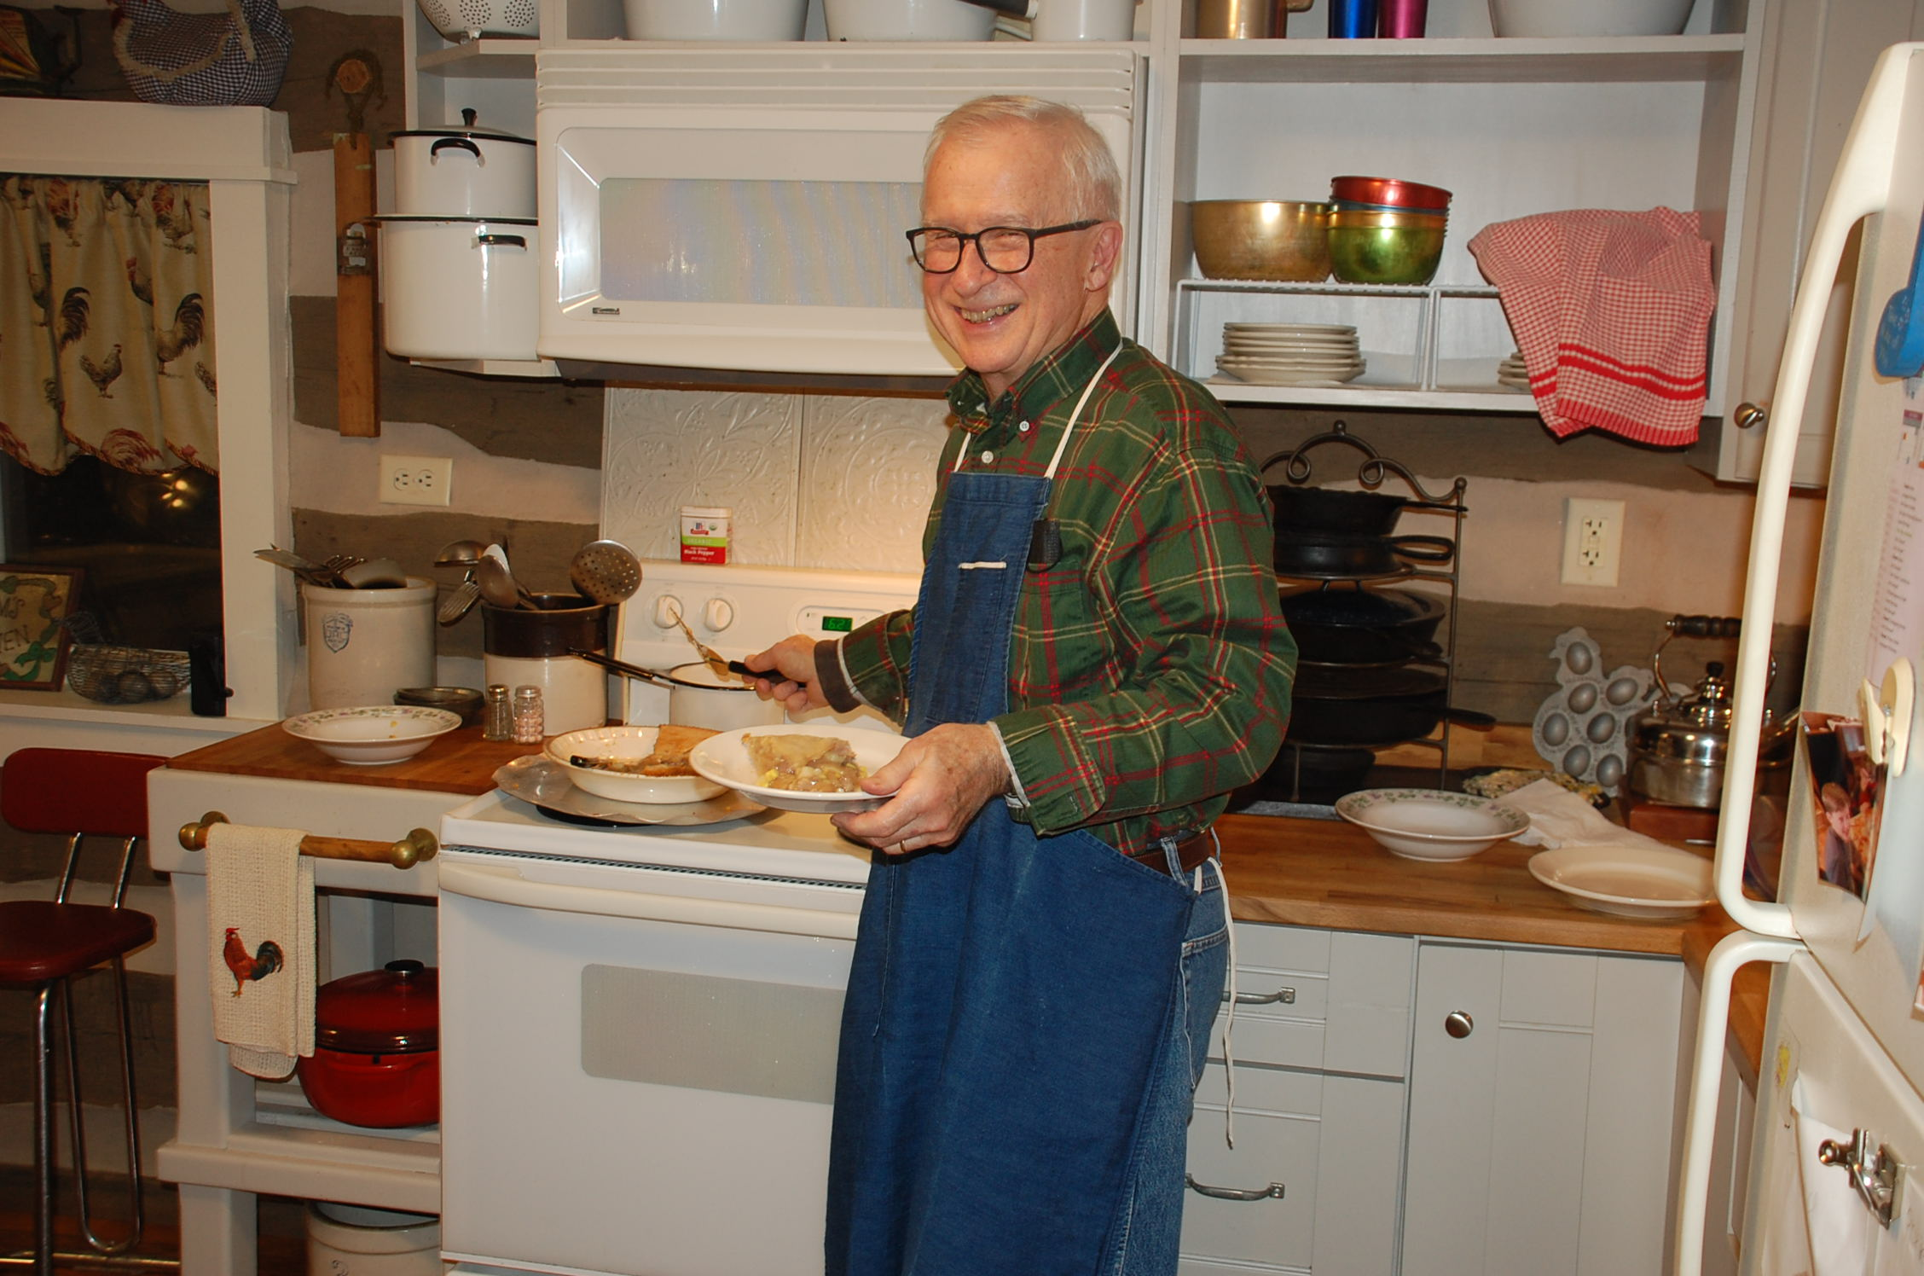
Hunter is also a serious re-enactor. He is a skilled musician and had a military career, during which he played “tuba in the band, and, also, trombone, occasionally... the ceremonial trumpet for retirement ceremonies, and string bass in the jazz band.”
Gregorian chanting is one of his daily re-enacting activities, about which more later.
During our visit he was also the cook and made healthy dishes that tasted good, not always easy to do.

Slide 6
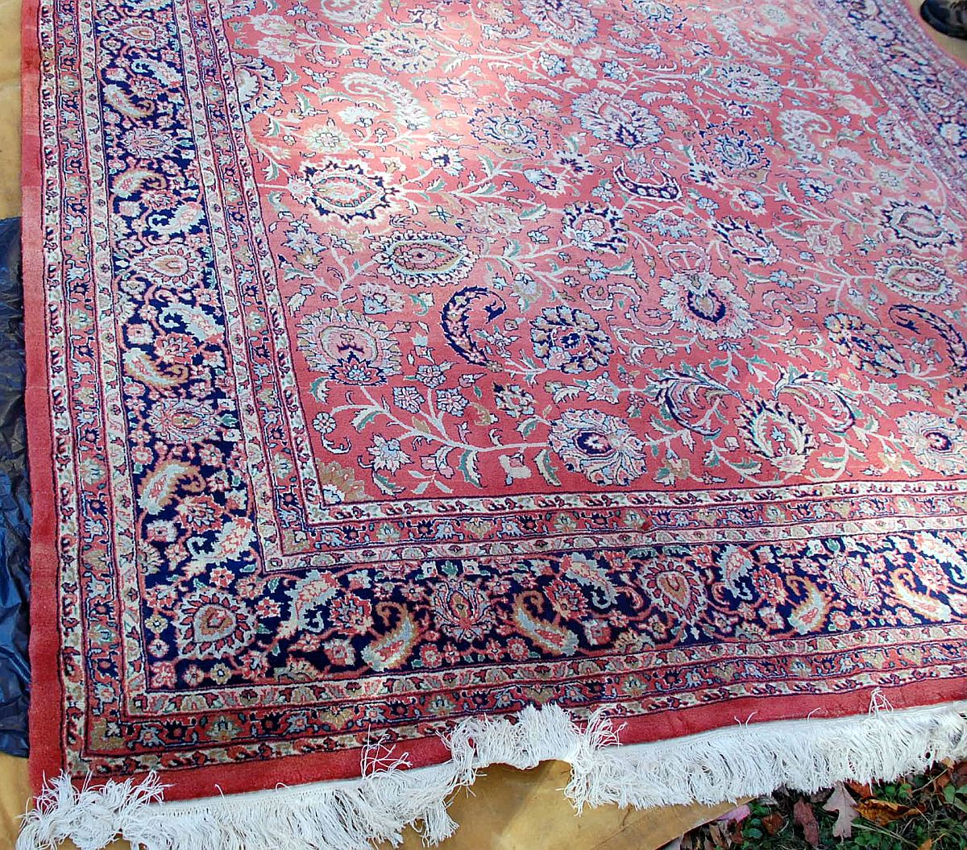
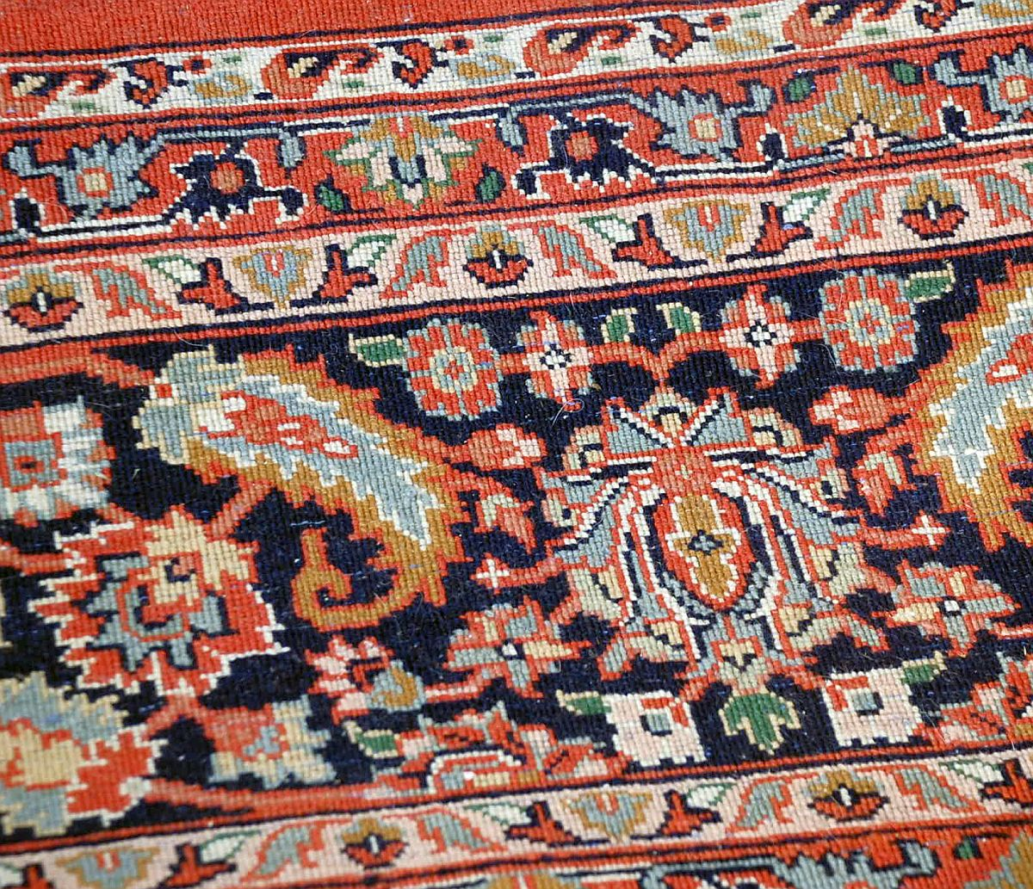
So, they decided that they needed to sell it and contacted me, asking about possibilities.
We’re going to talk about Hunter’s chanting, but we want to say here that Hunter has had teacher and coach, a noted expert in Gregarian chant. Hunter has sometimes traveled to the teacher/coach’s home in Berkeley, CA and stayed with him to learn and practice his chanting. (This teacher/coach died recently in his 90s.)
One reason to mention this early is that the teacher/coach once gave Hunter and Janice a room-sized oriental rug, saying that it might have “some value.”
The Hensley’s used this rug for a number of years, but found, when they moved to this cabin that they did not have a room in which this room could be visibly used. It would, in a room in which it would fit, be covered largely with furniture.
Of course, the decorative rug market is largely dead, but I contacted Colin, who is more conversant with this market than I, and we decided we needed to look at this rug “in the wool.” More, a visit to the Hensley’s would be interesting and enjoyable.
So, we scheduled the visit on which you are already along with us.

Slide 7
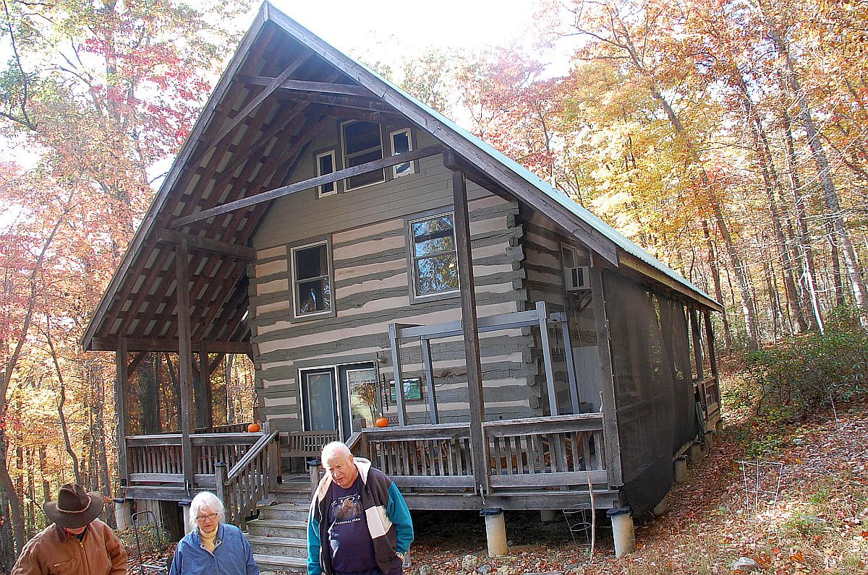
It’s a long drive from the DC area to their place in a remote area near Roanoke.
They had to meet us and lead us in for the last half hour.
But then we arrived we were facing their nice log cabin.

Slide 8
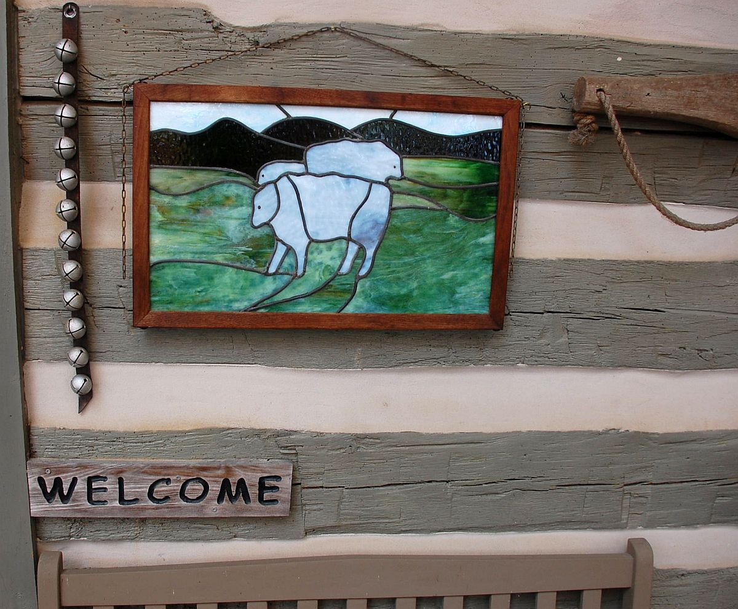
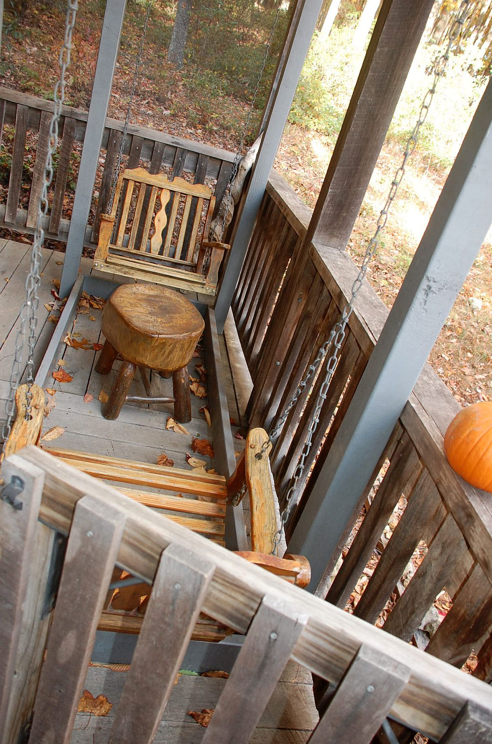
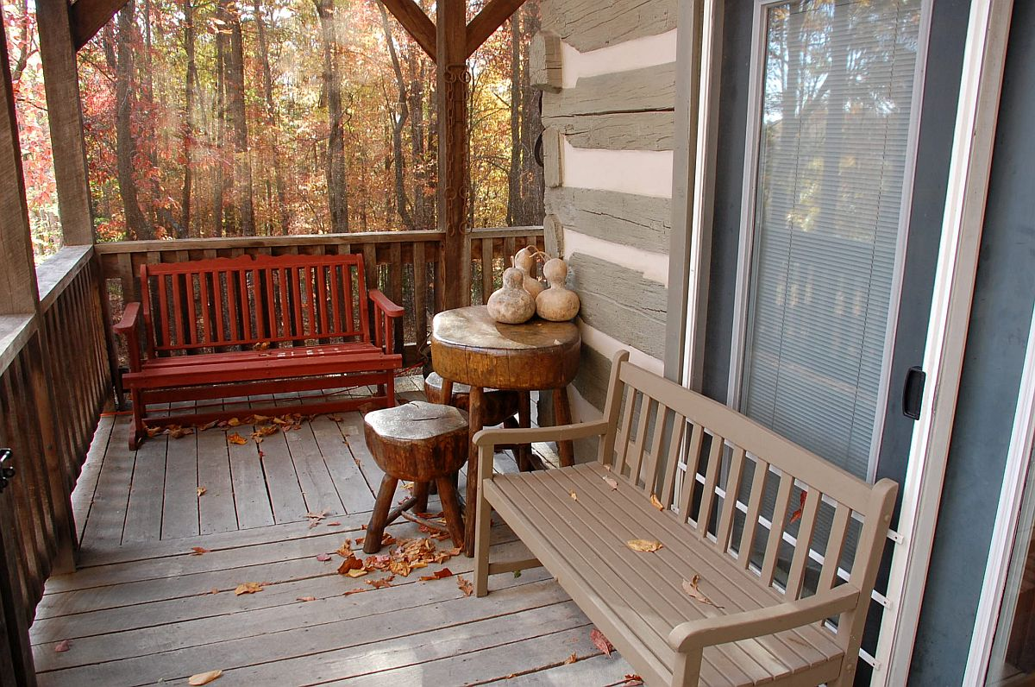
We looked around the porch and they said that the logs of their cabin were taken from a barn and were of the Civil War era.

Slide 9
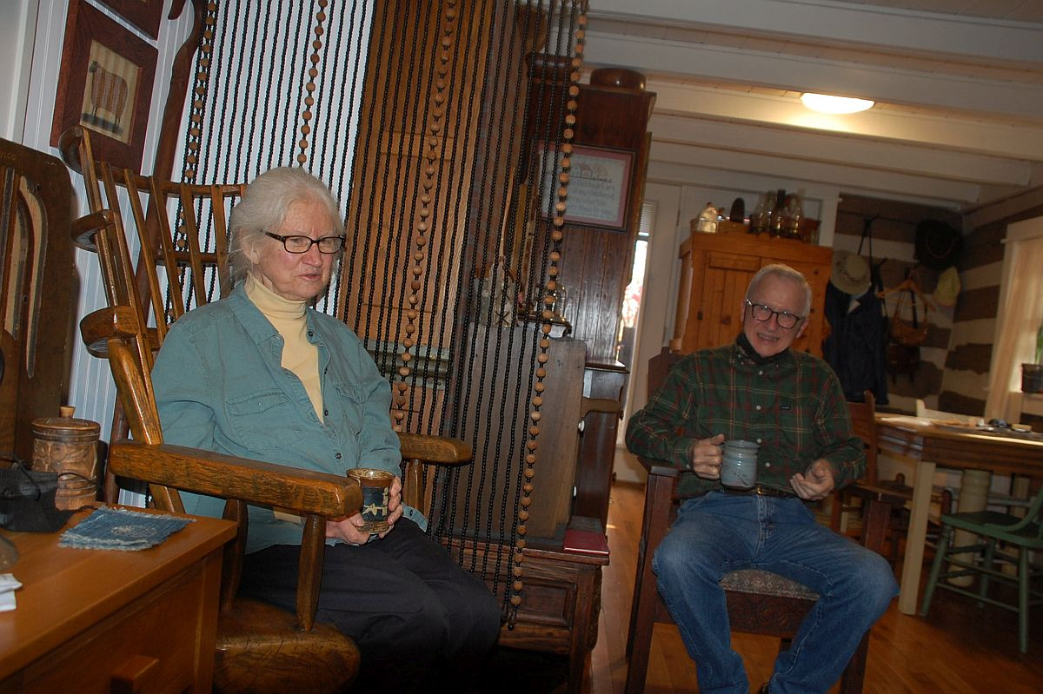
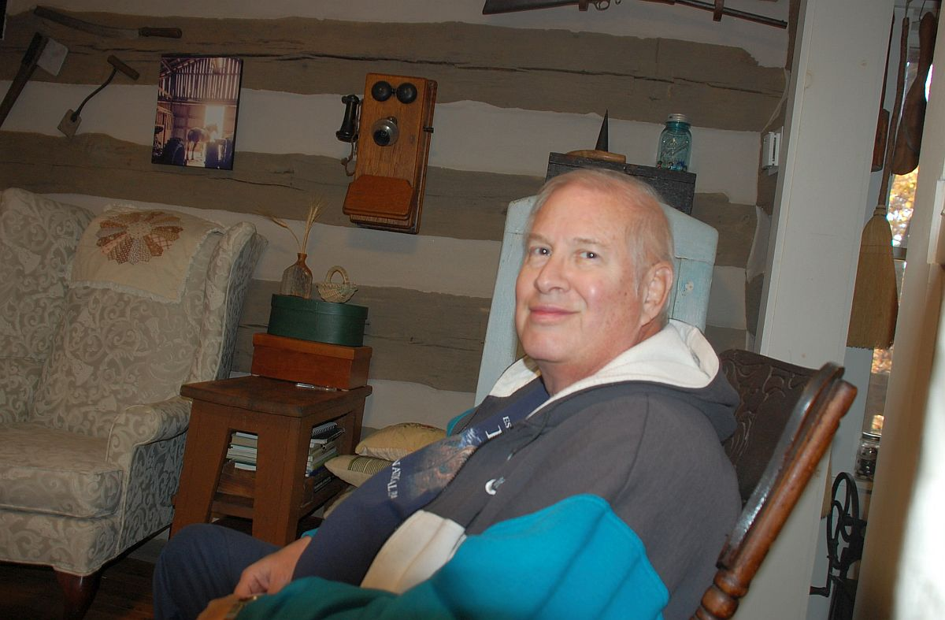
We sat in a first-floor area and Hunter served us a hot mulled drink.
After a little while, I asked them to allow me to walk around the cabin and take photos.
That’s what goes on in the next series of slides, sometimes without text.

Slide 10
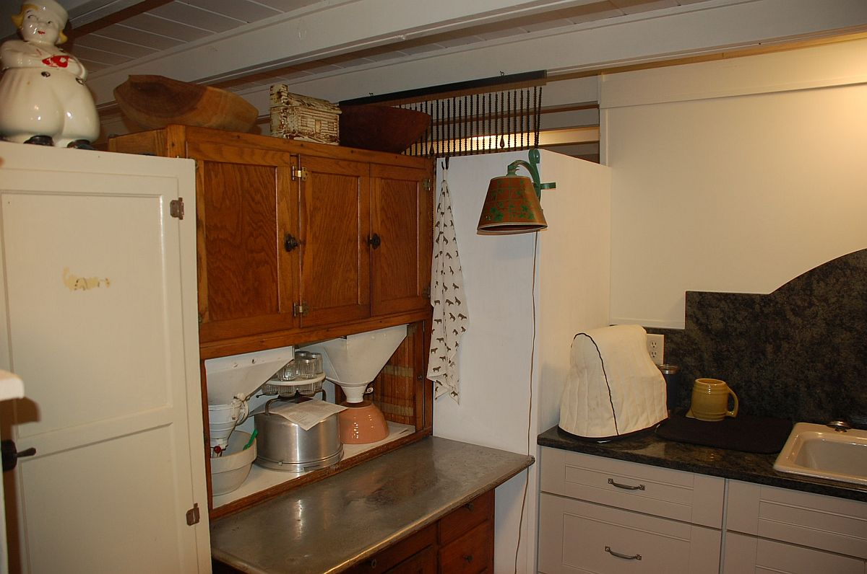
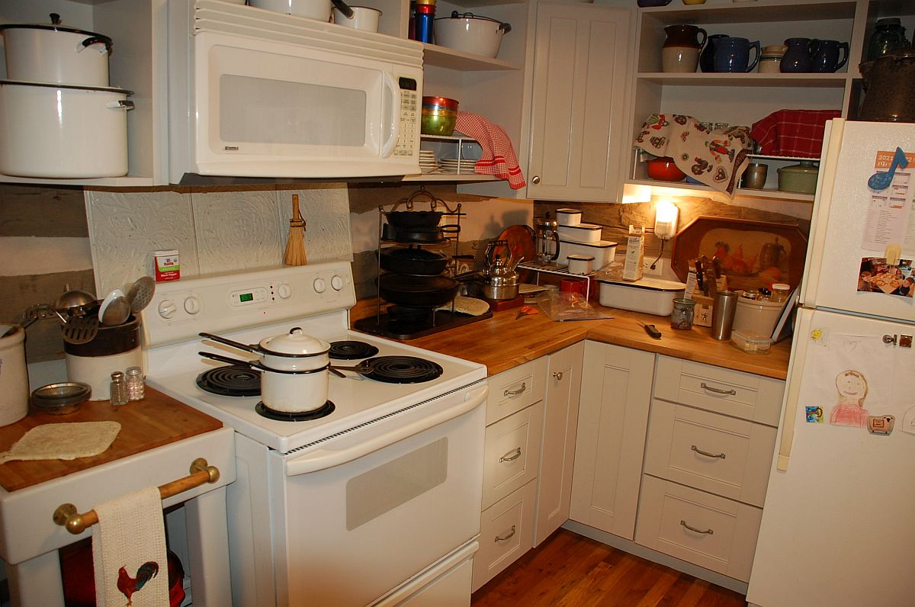
We looked around the kitchen and its adjoining areas.

Slide 11
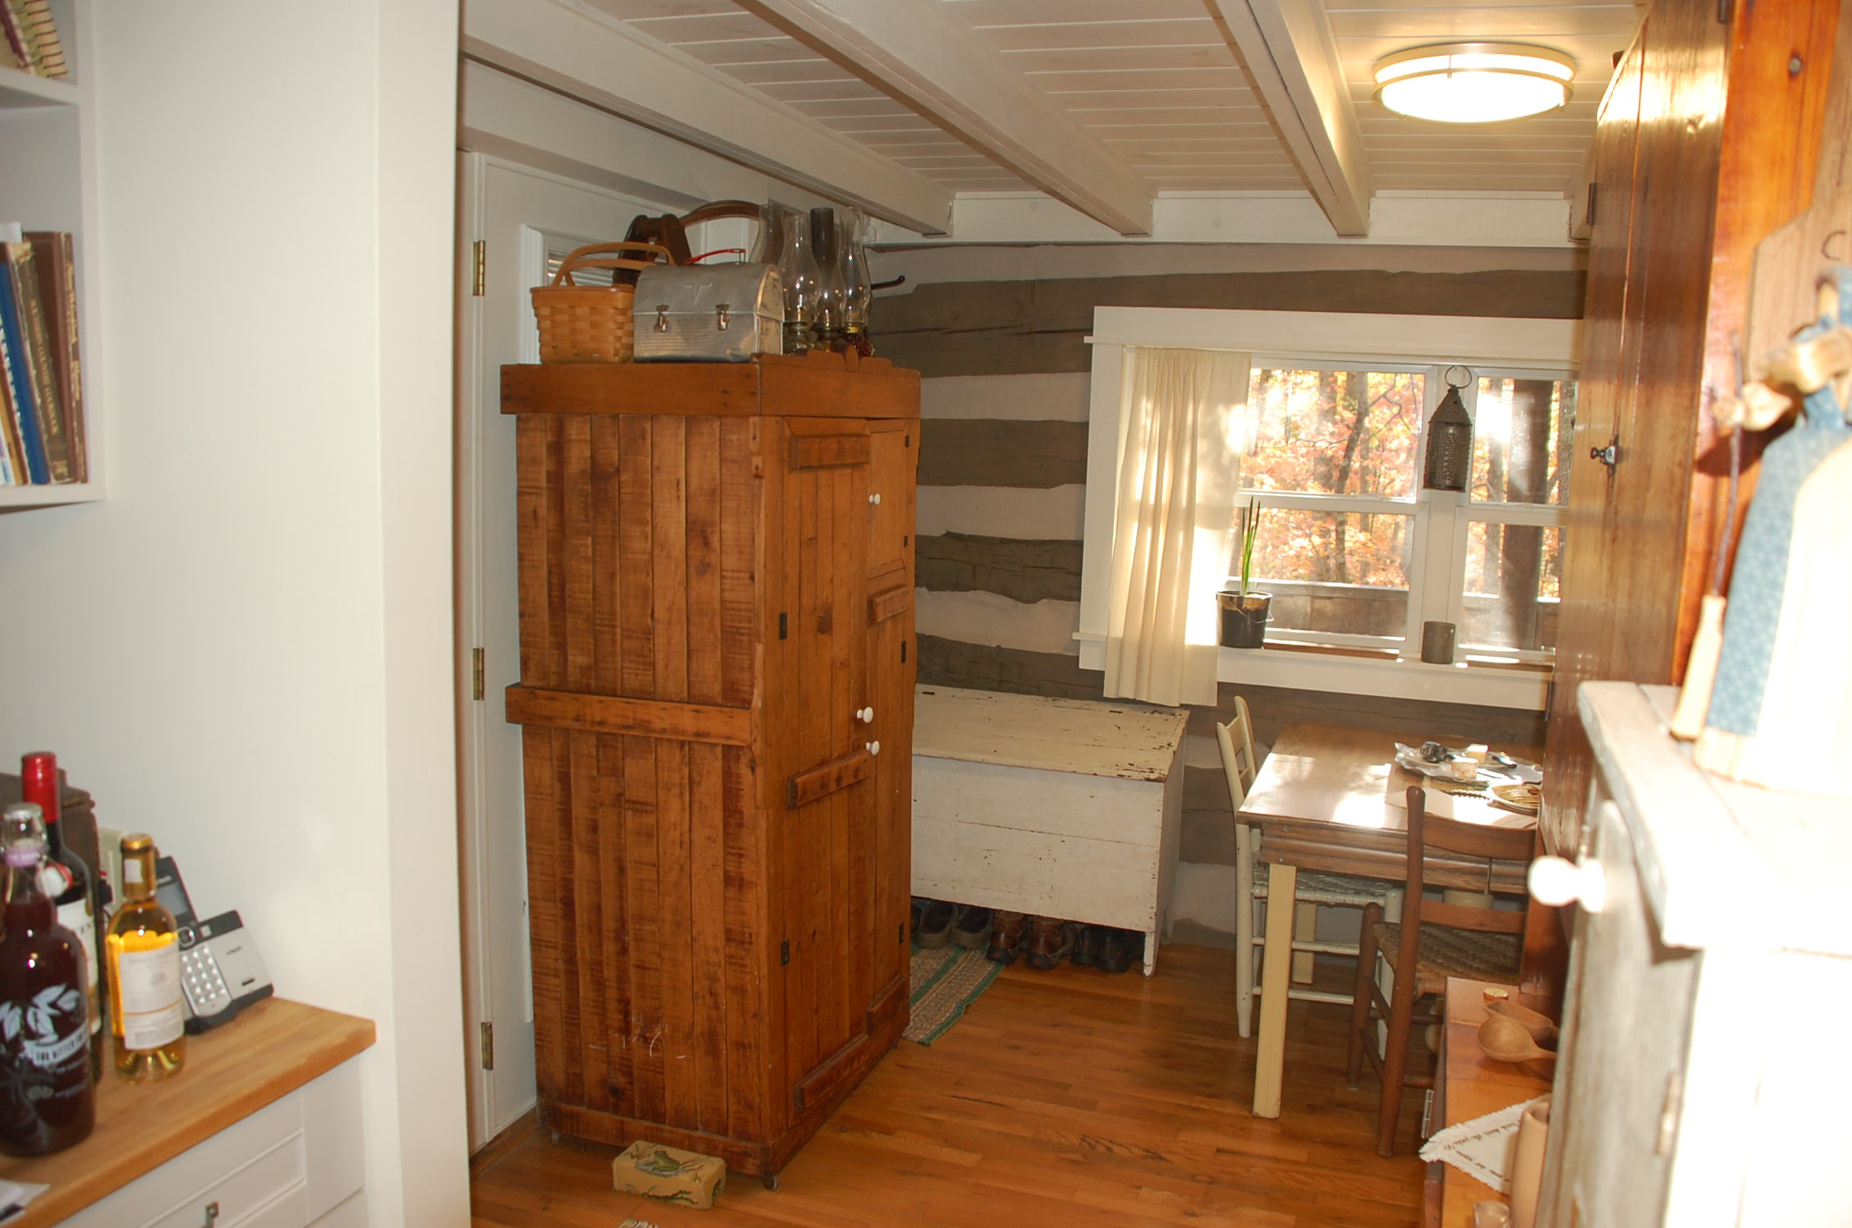
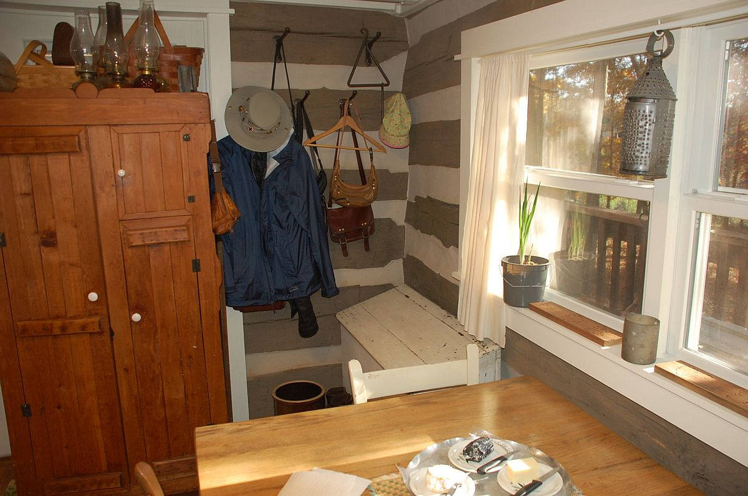
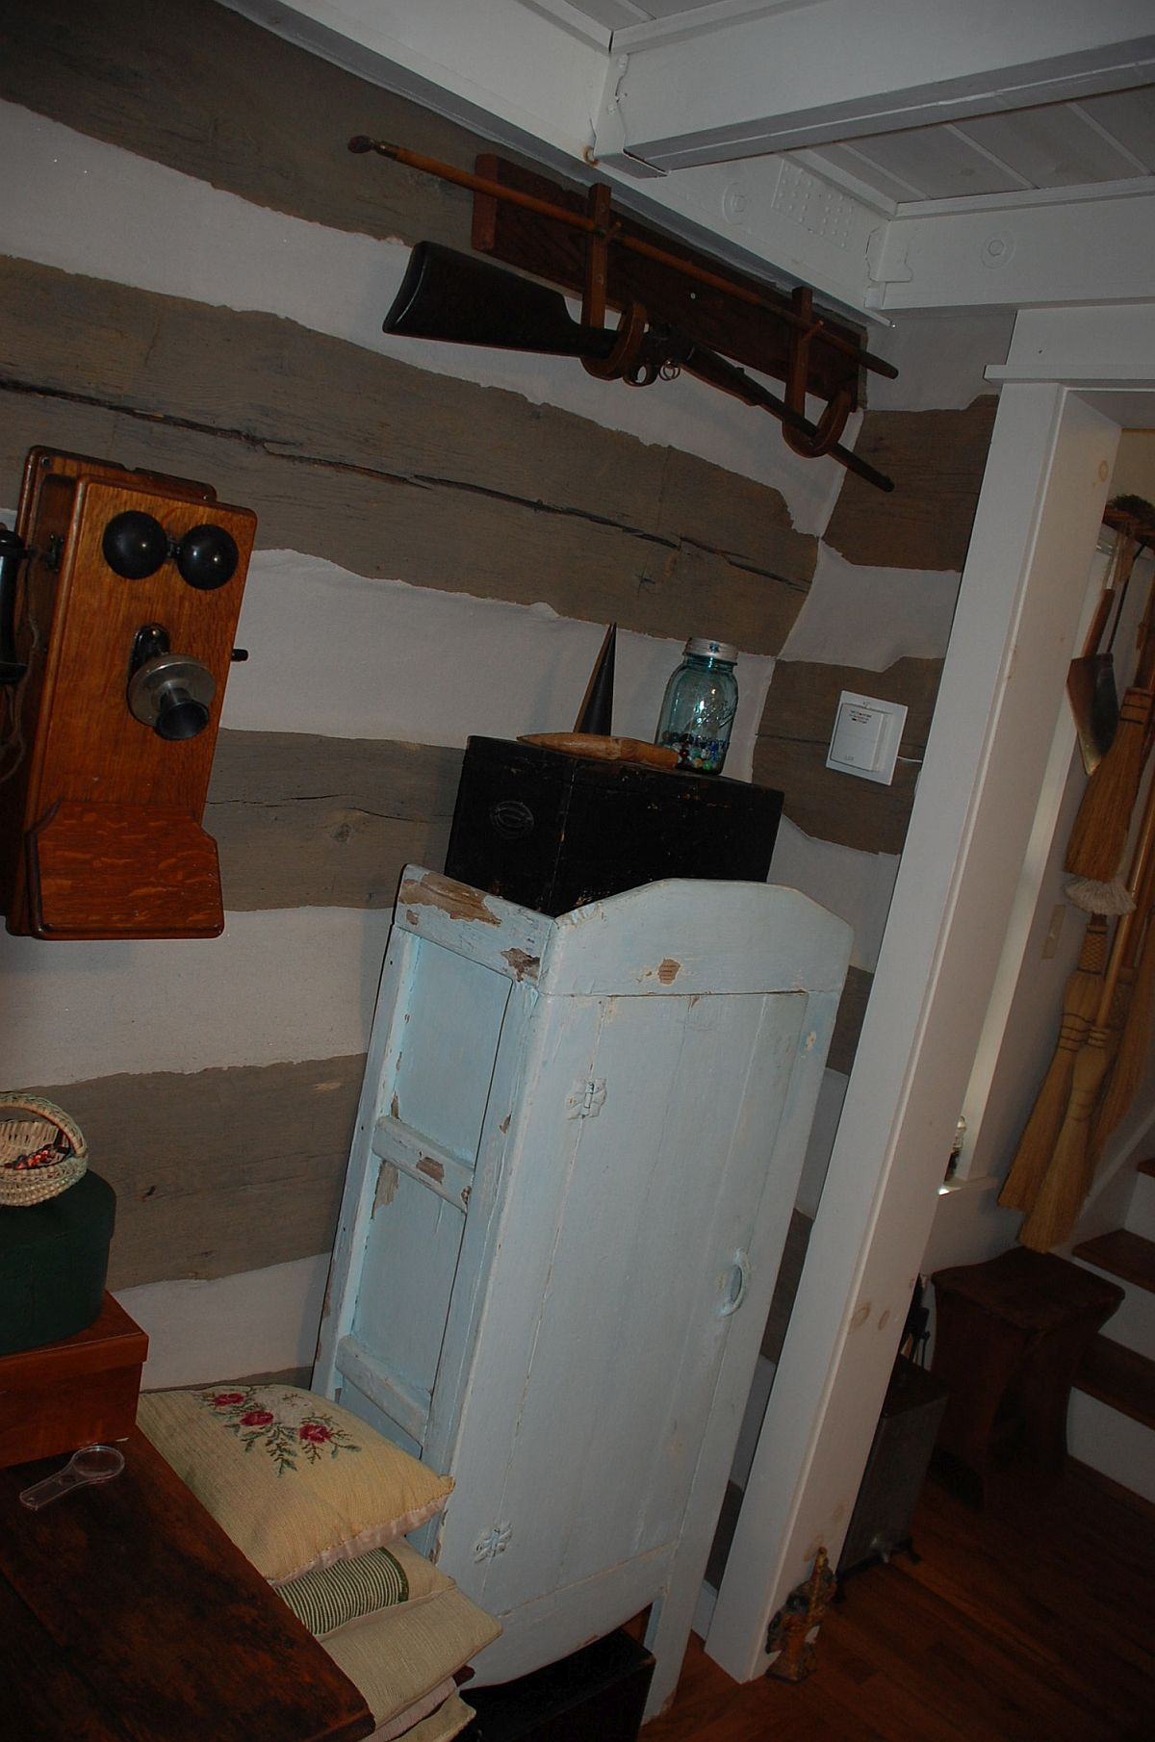

Slide 12
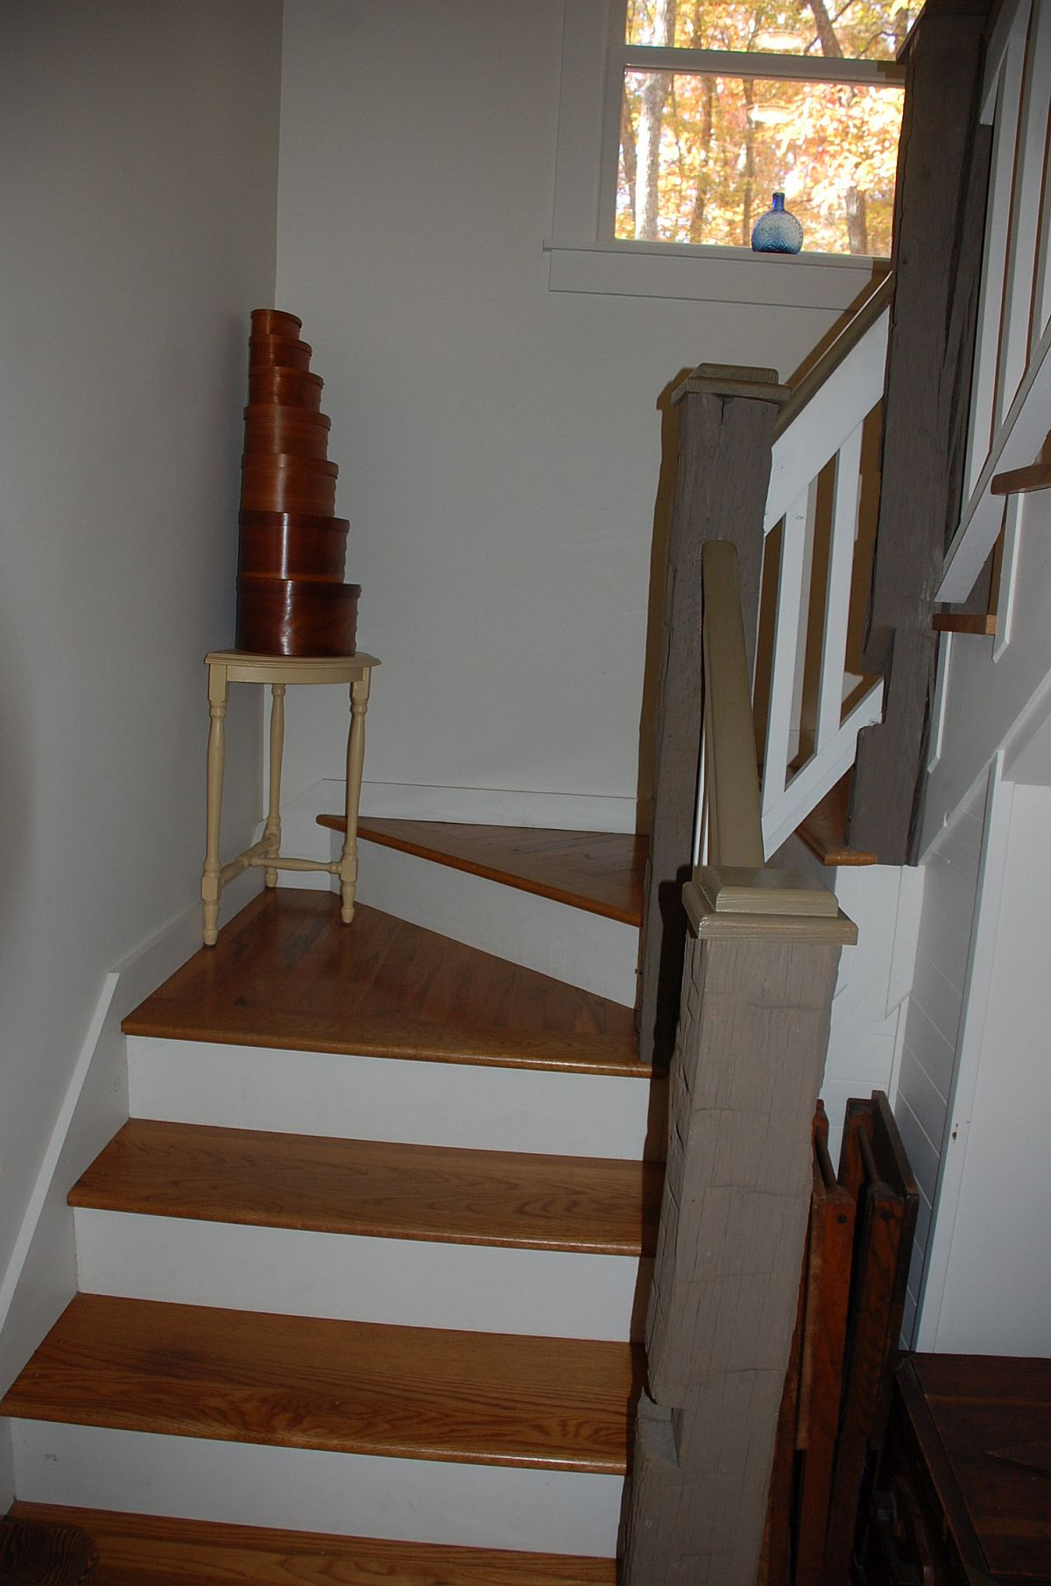
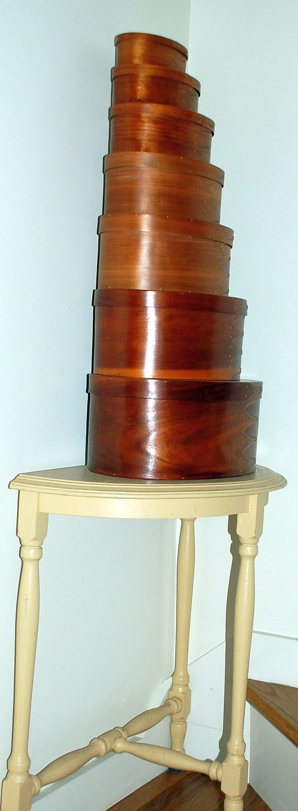
Next, I asked go upstairs. The flight has three sections, turning to the right.
Going by, I wanted a closer look at a stack of nice Shaker-style boxes.

Slide 13
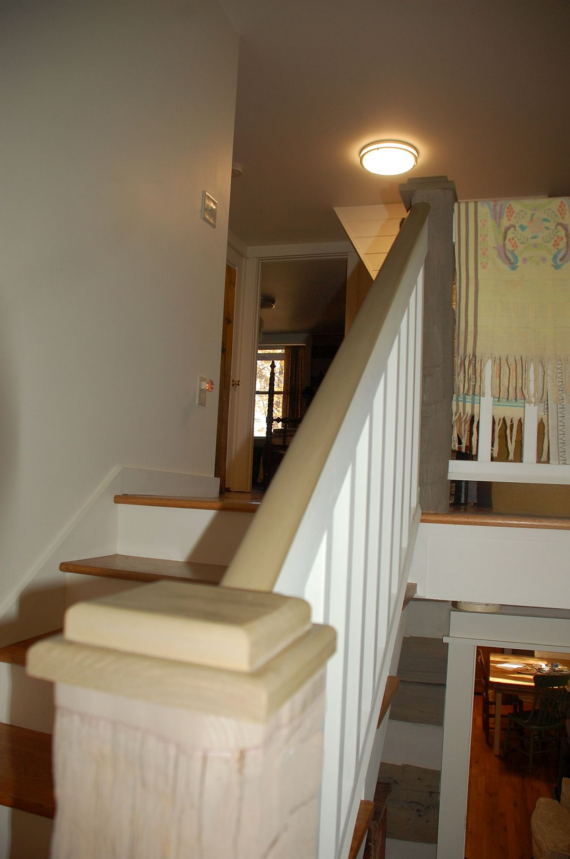
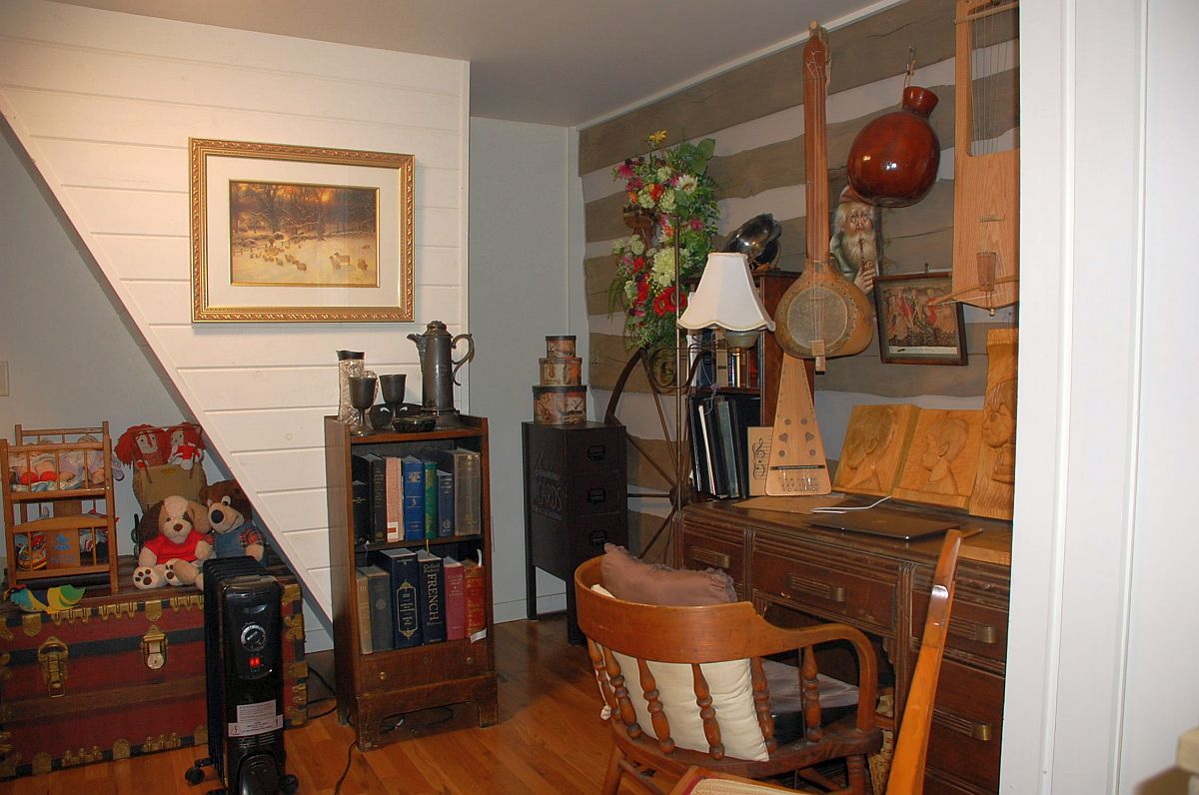
At the top of the stairs is an area that has a desk but seems also suited for child’s play

Slide 14
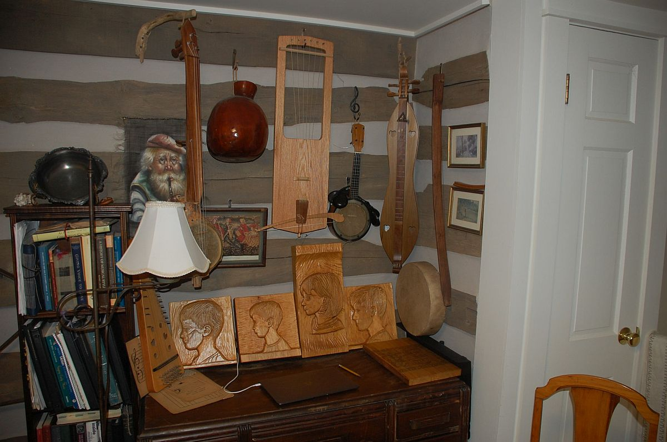
Another of Hunter’s re-enacting skills is ‘bas relief’ sculpture.
Here are some realistic sculptures he has done on profiles of their grandchildren.

Slide 15
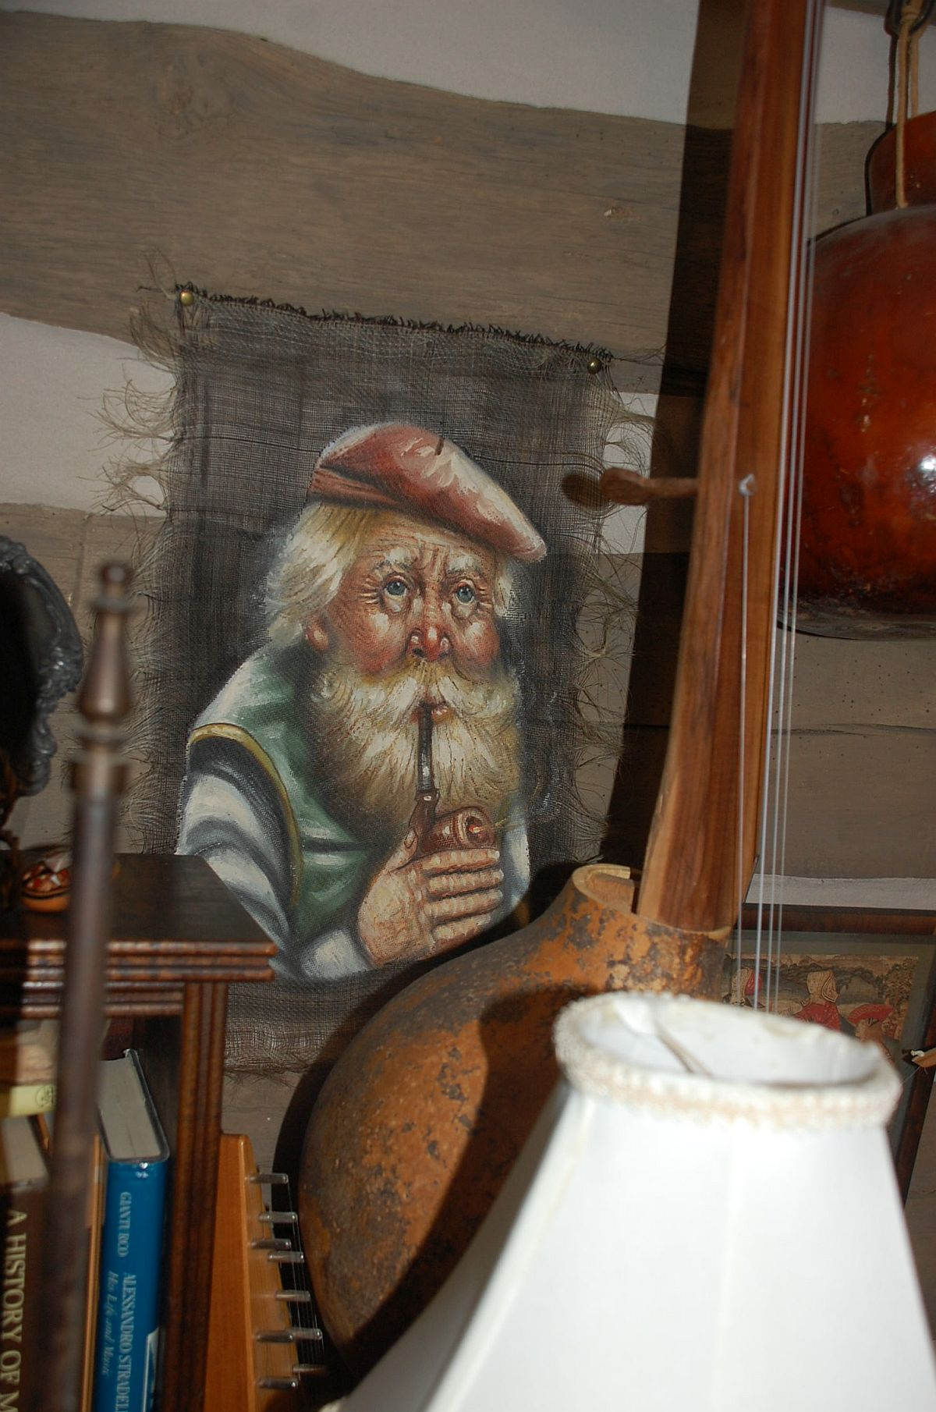
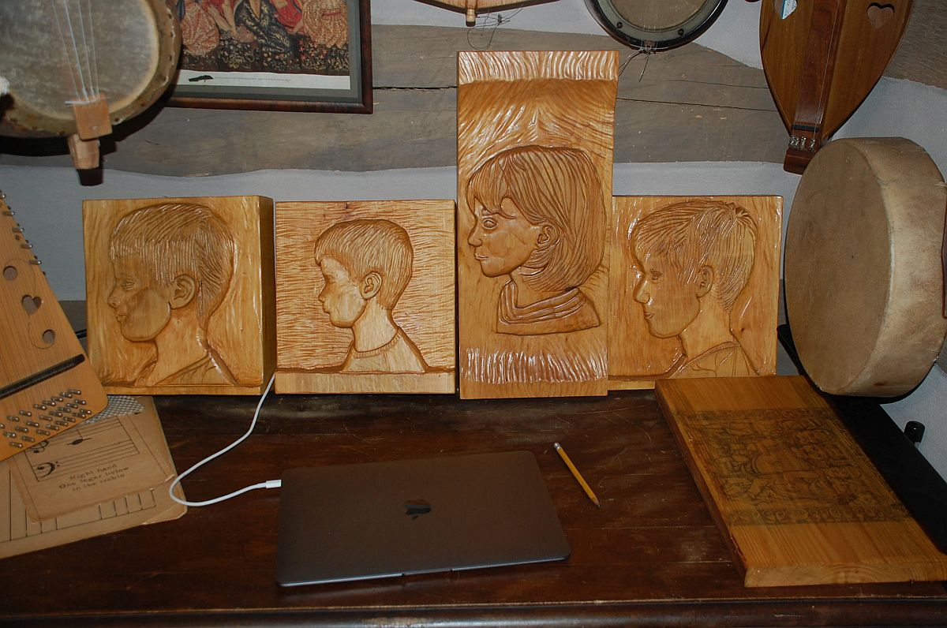
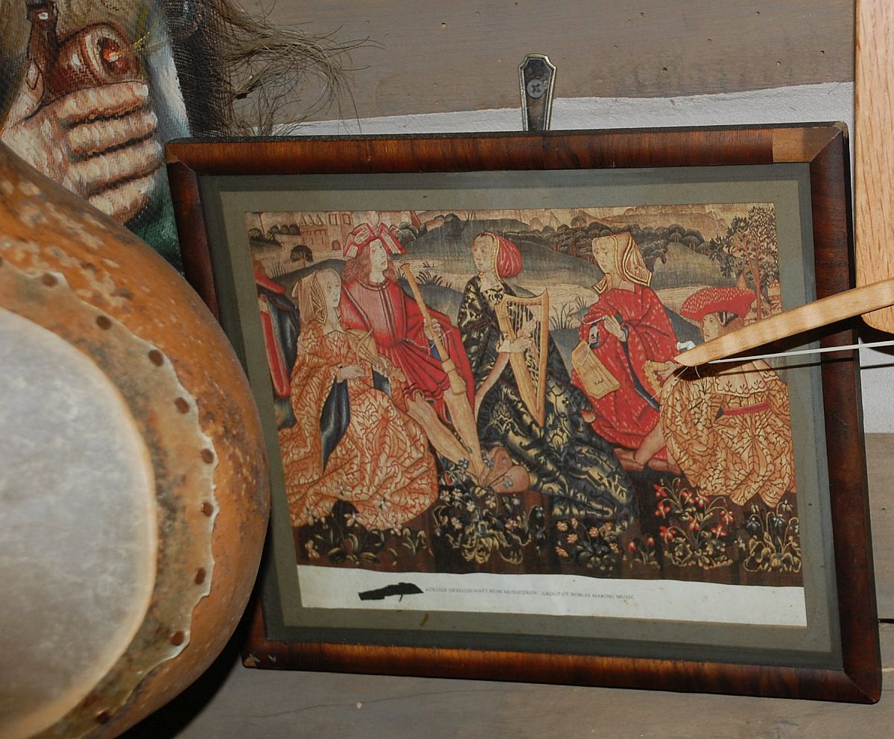
A closer look at these sculptures. Decorations are everywhere and are interesting and well-chosen

Slide 16
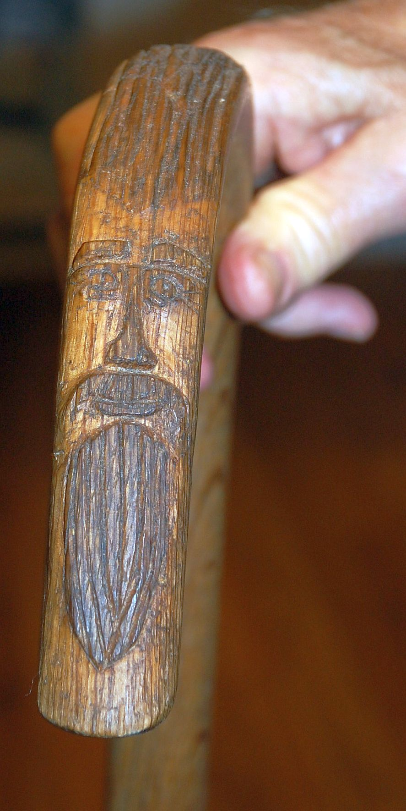
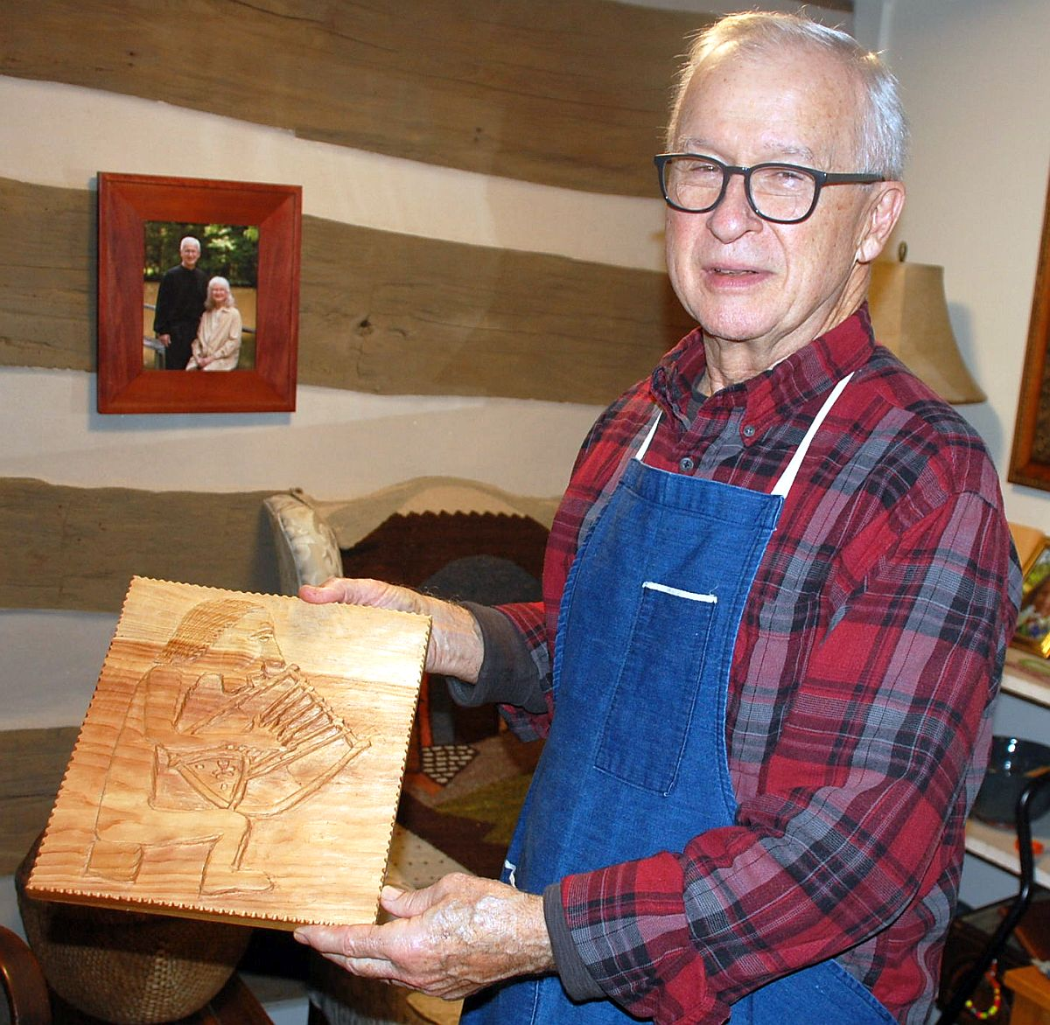
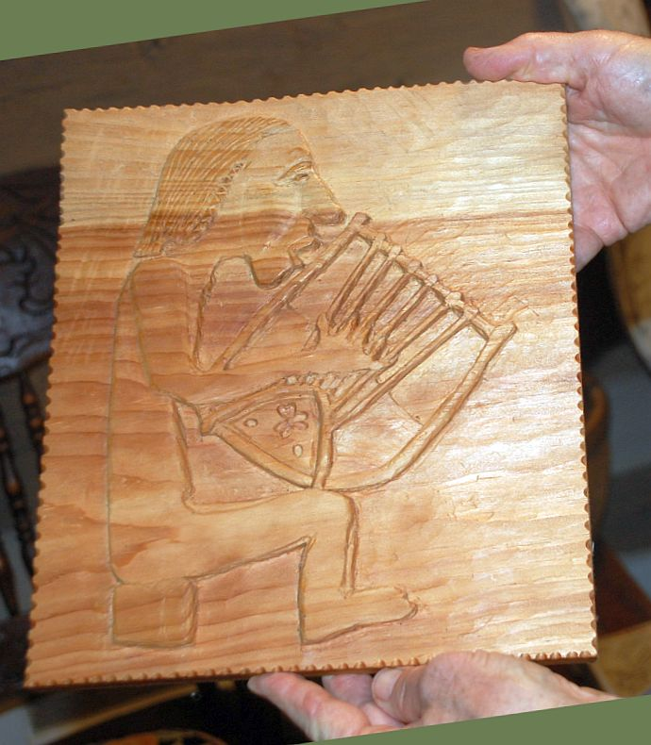
Two more instances of Hunter’s carving.
On the left above is the carved handle of a cane.
On the center, above, and on the right, are two images of a man playing a harp.

Slide 17
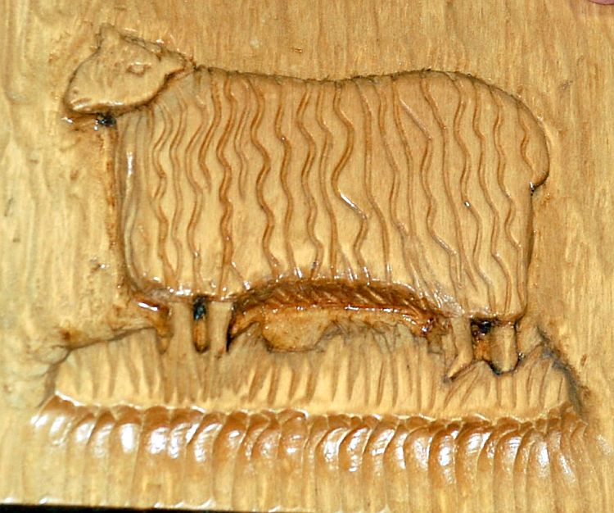
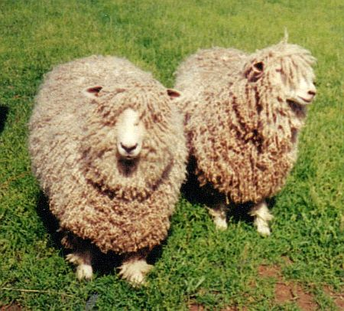
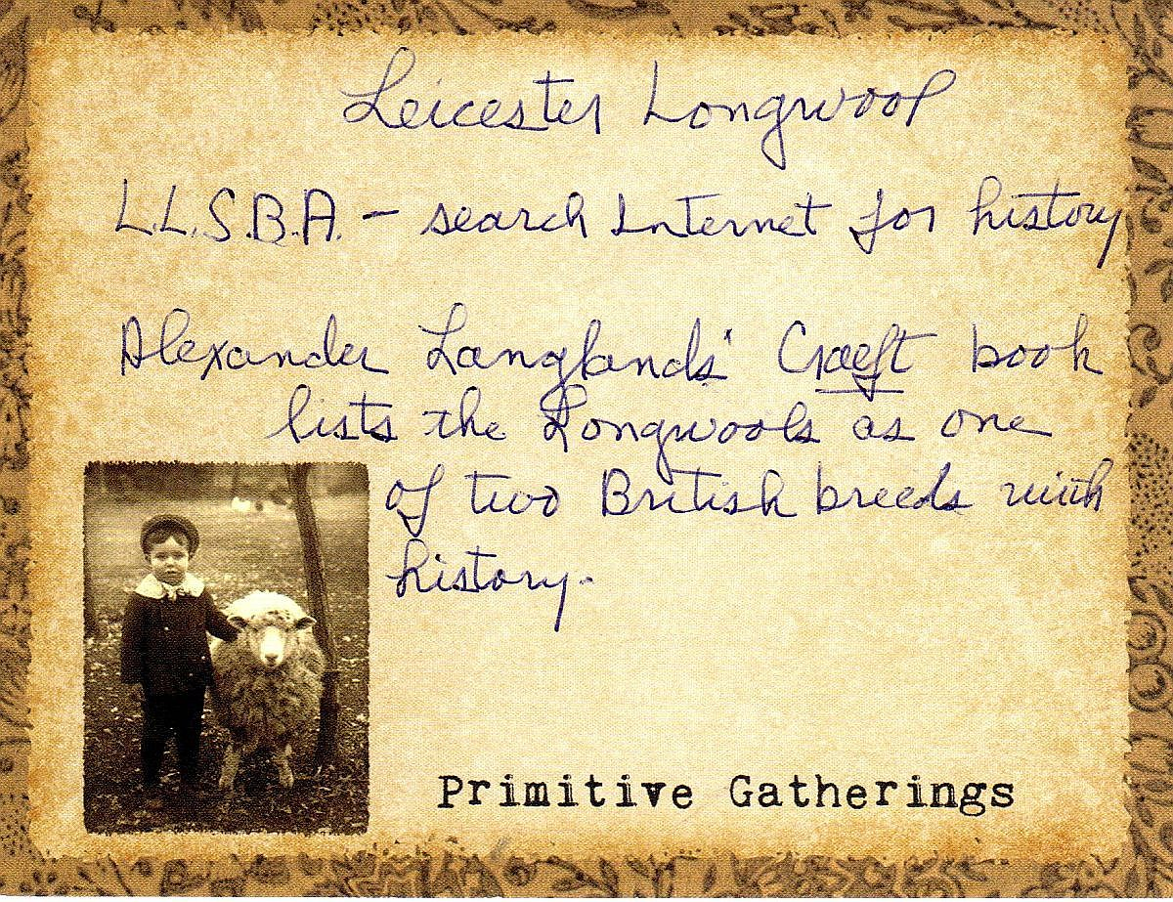
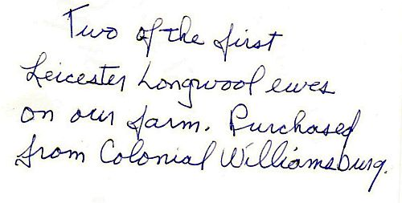
There is even a carving of the long-wool Leicester sheep they kept when they lived in Kentucky.
Janice sent me some info on that breed. Let’s digress a bit.

Slide 18
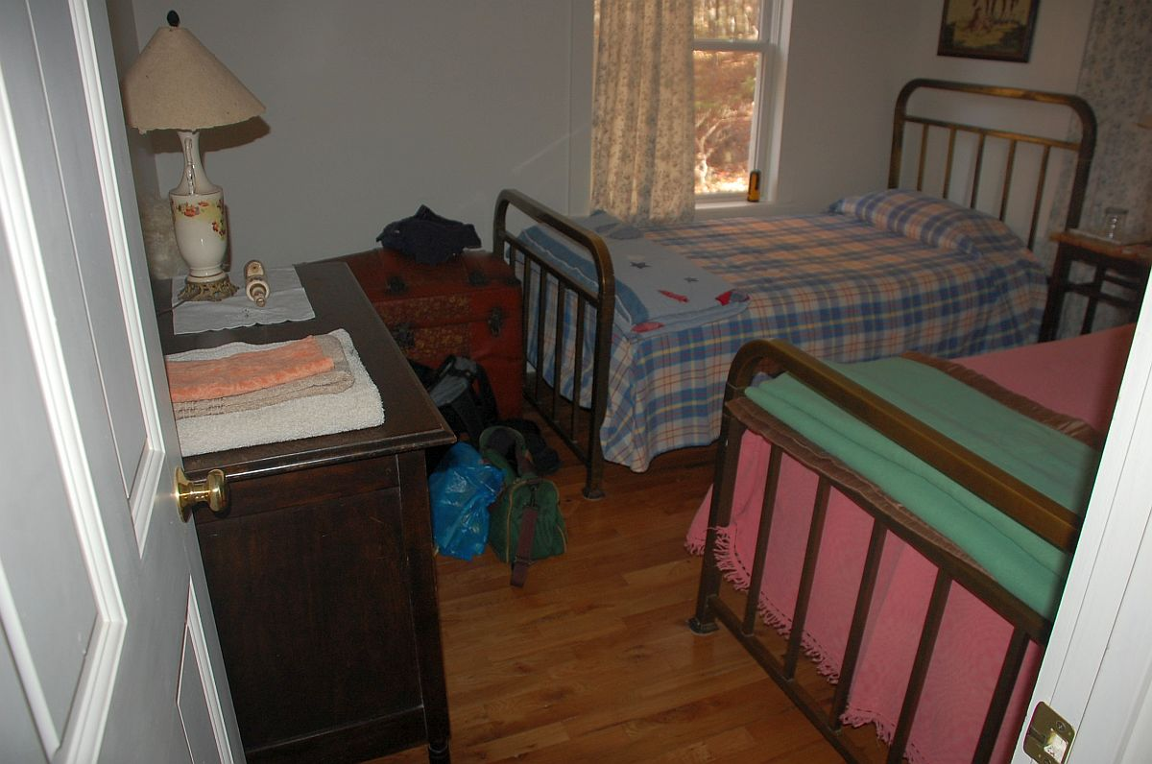
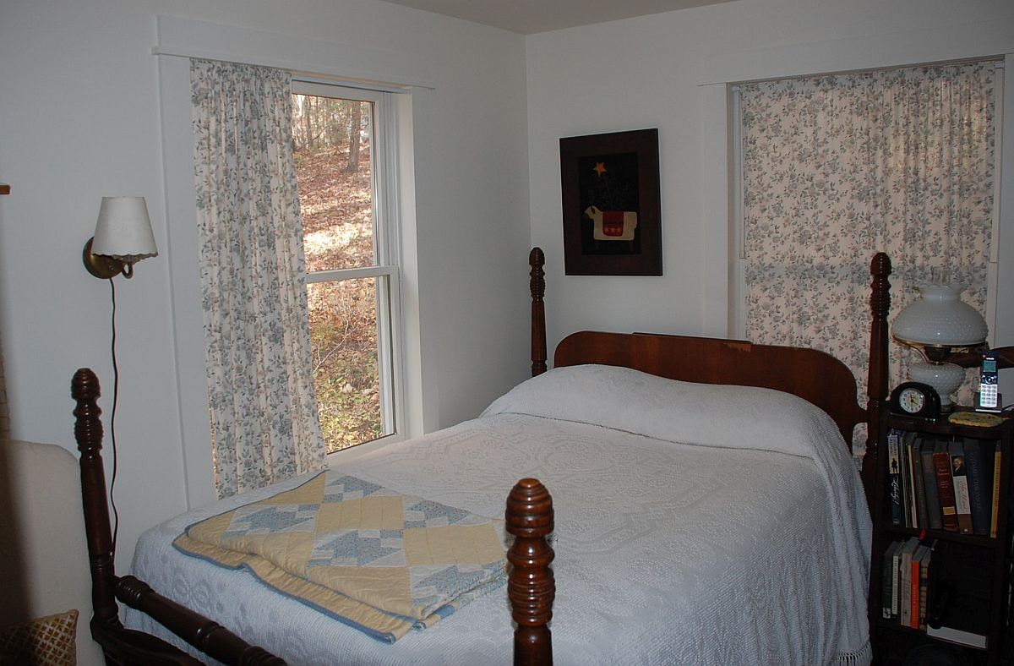
We’re continuing our look around upstairs.
There are two bedrooms. One has two single beds and the other a double bed.
They have a bedroom downstairs and are set up to be able to host children with grandchildren.
A compact bathroom with a shower is tucked in between them.

Slide 19
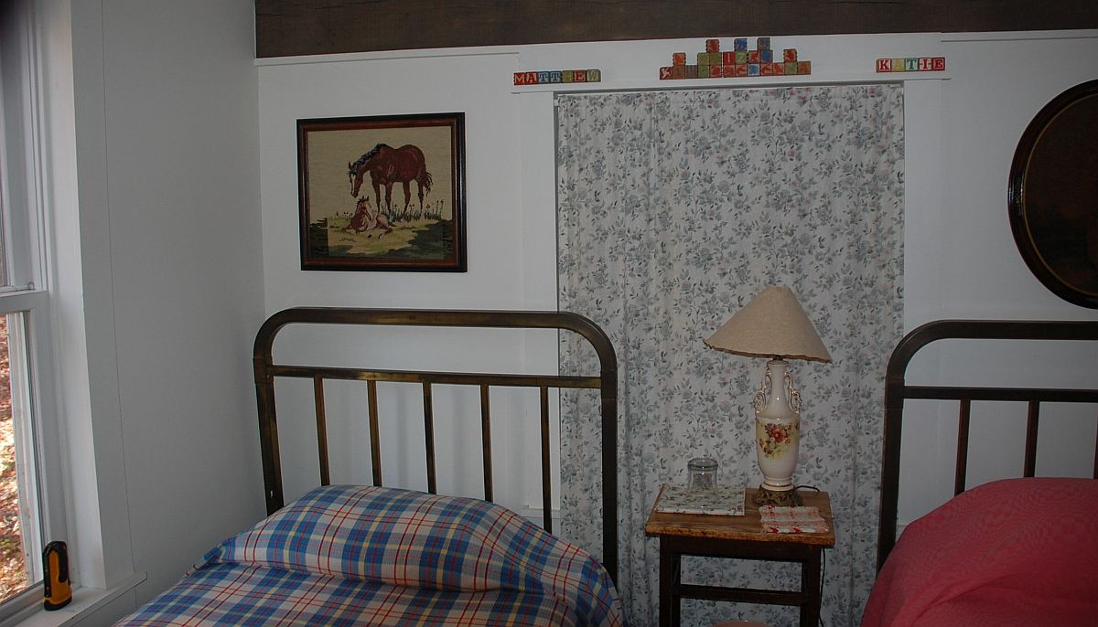
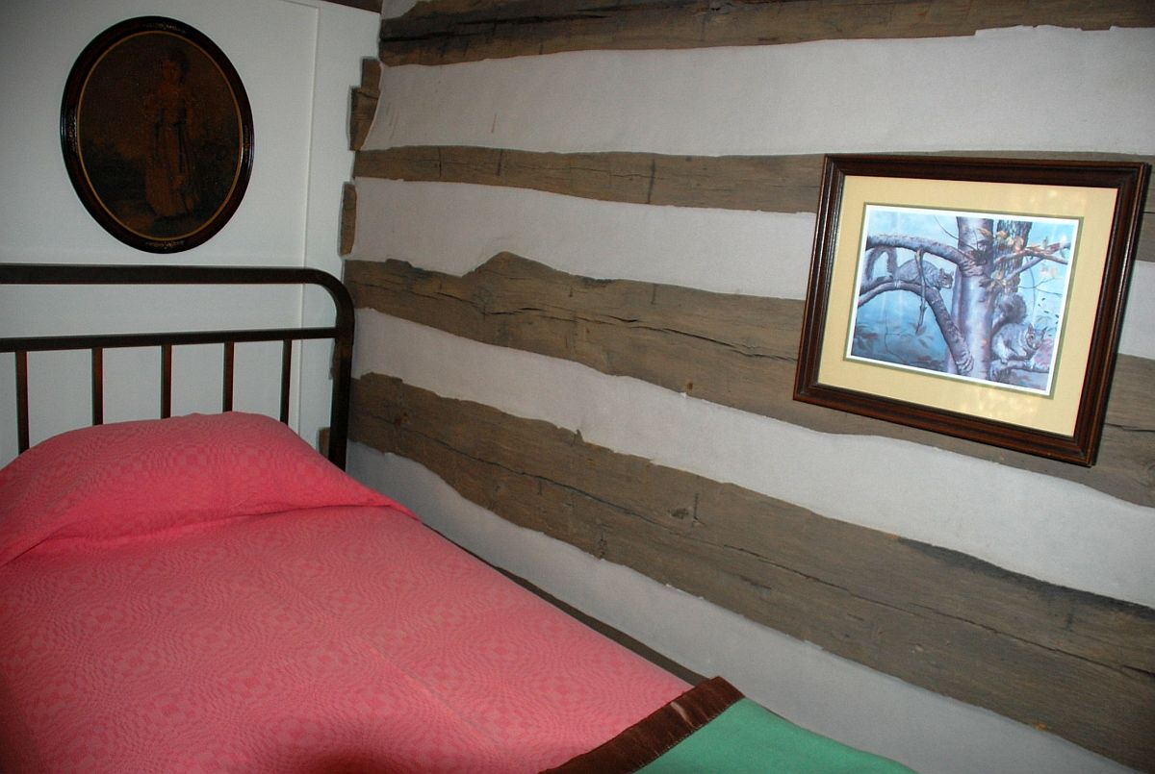
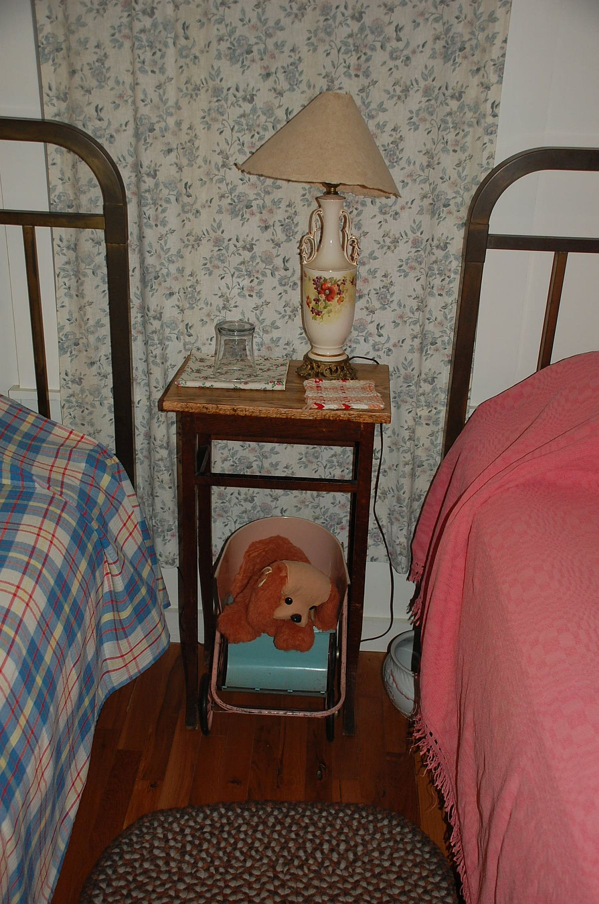

Slide 20
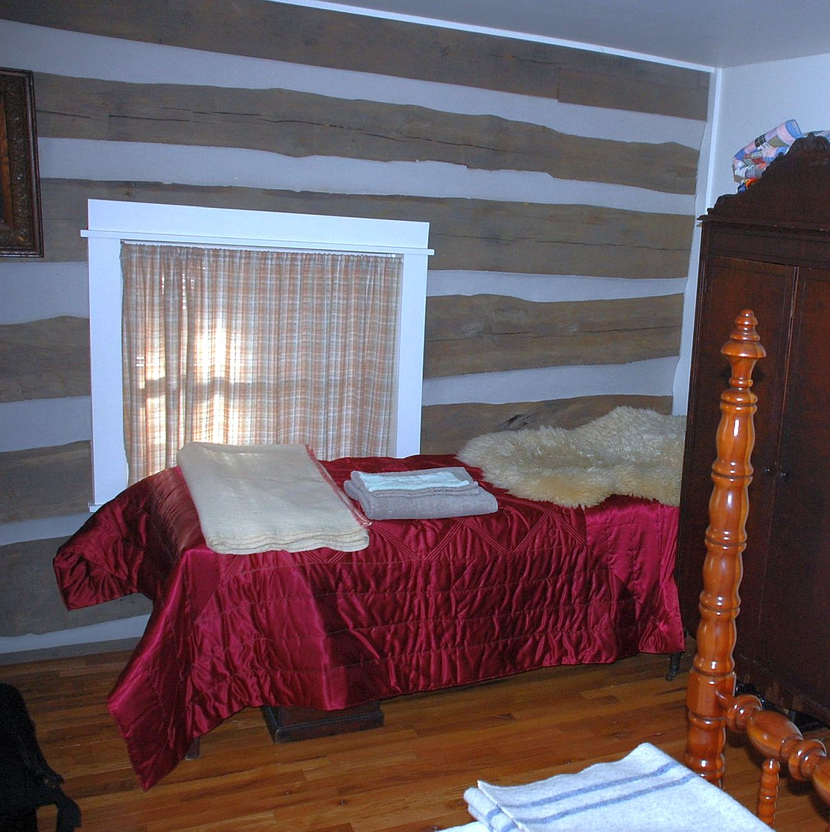
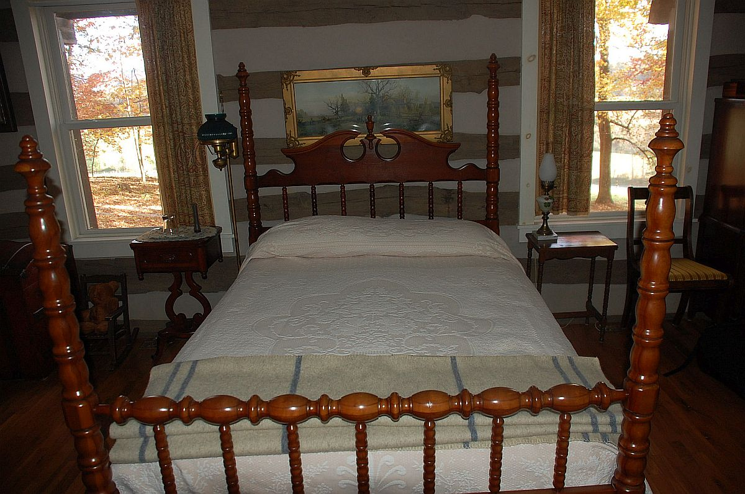

Slide 21
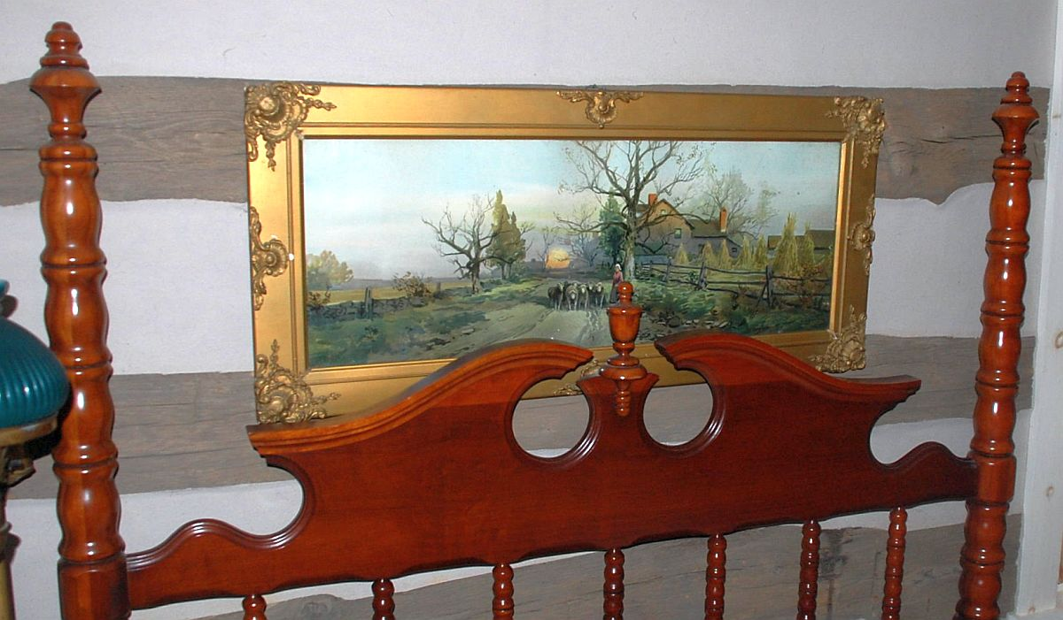

Slide 22
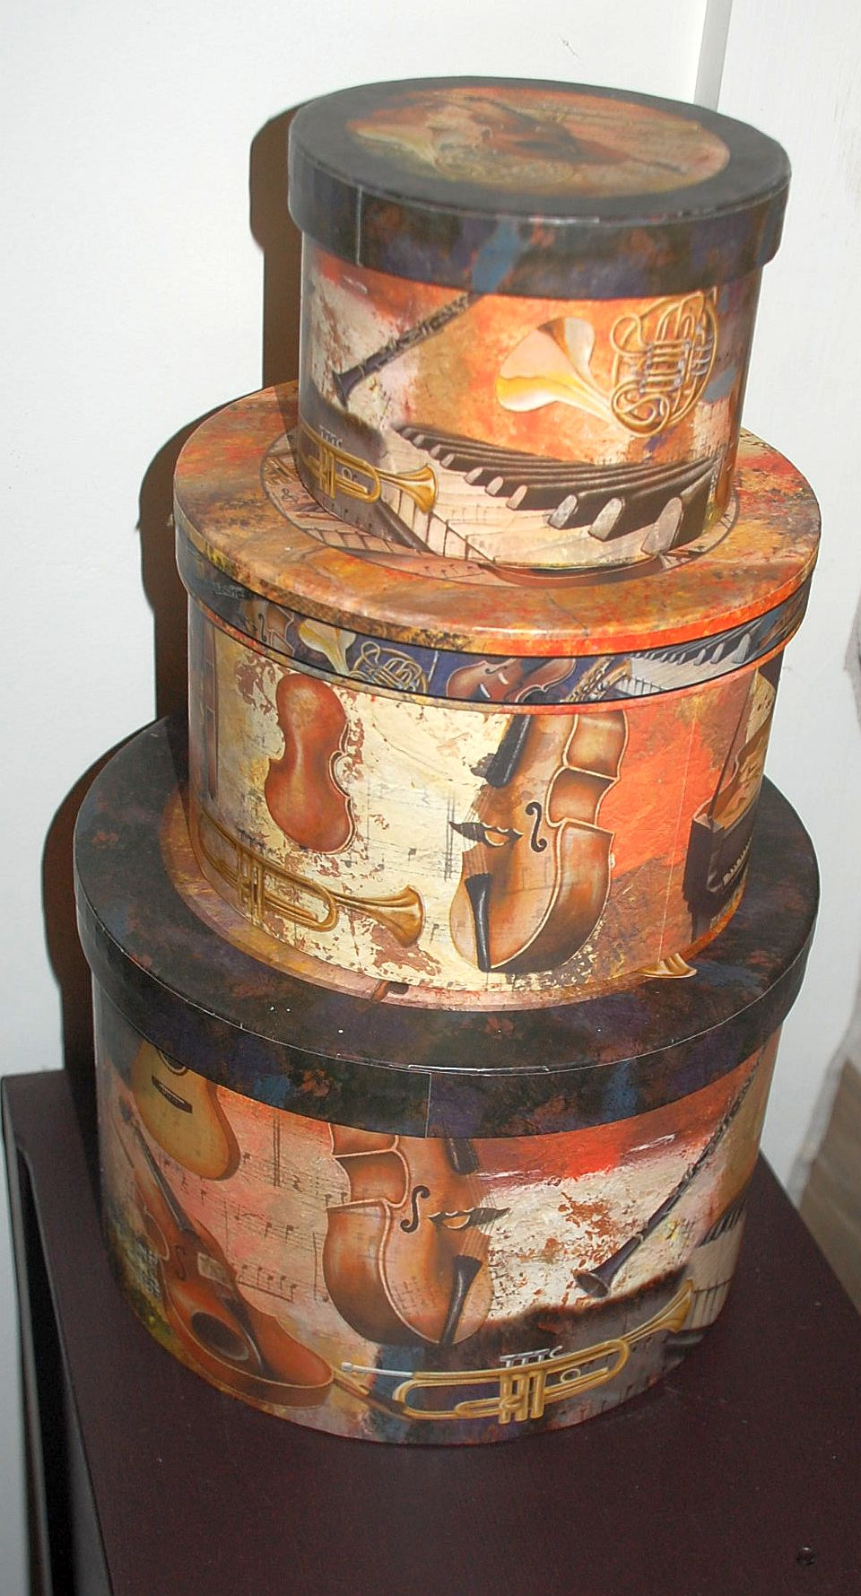
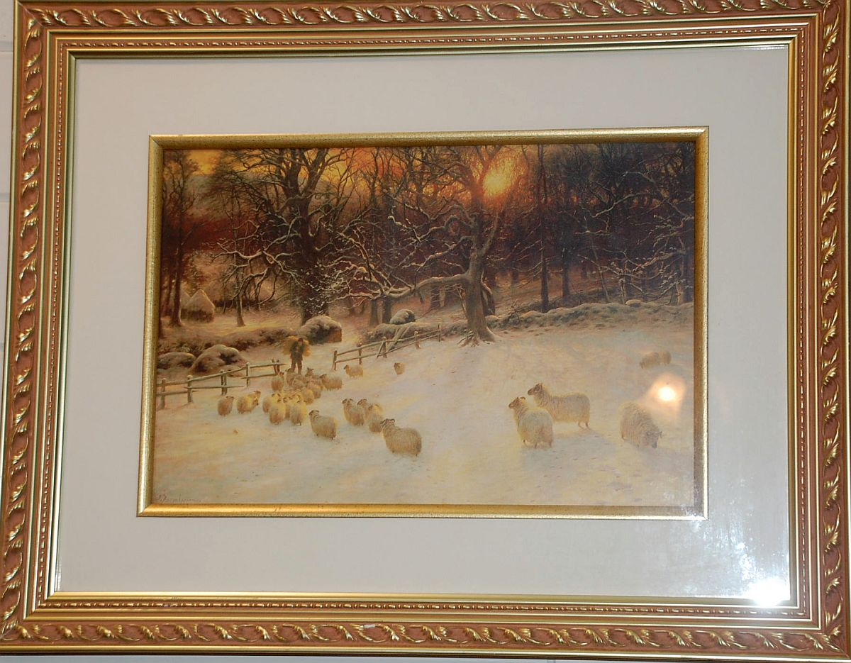
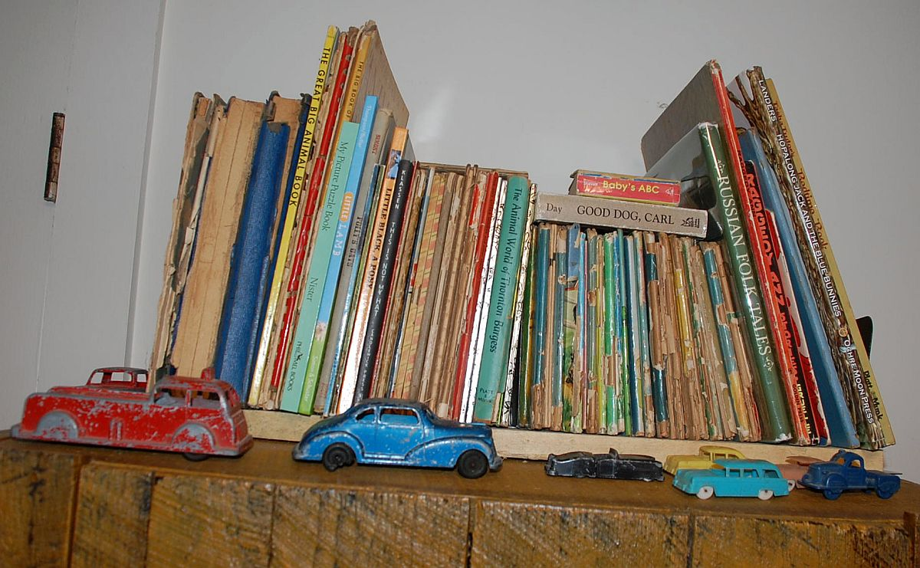
More interesting decorations.

Slide 23
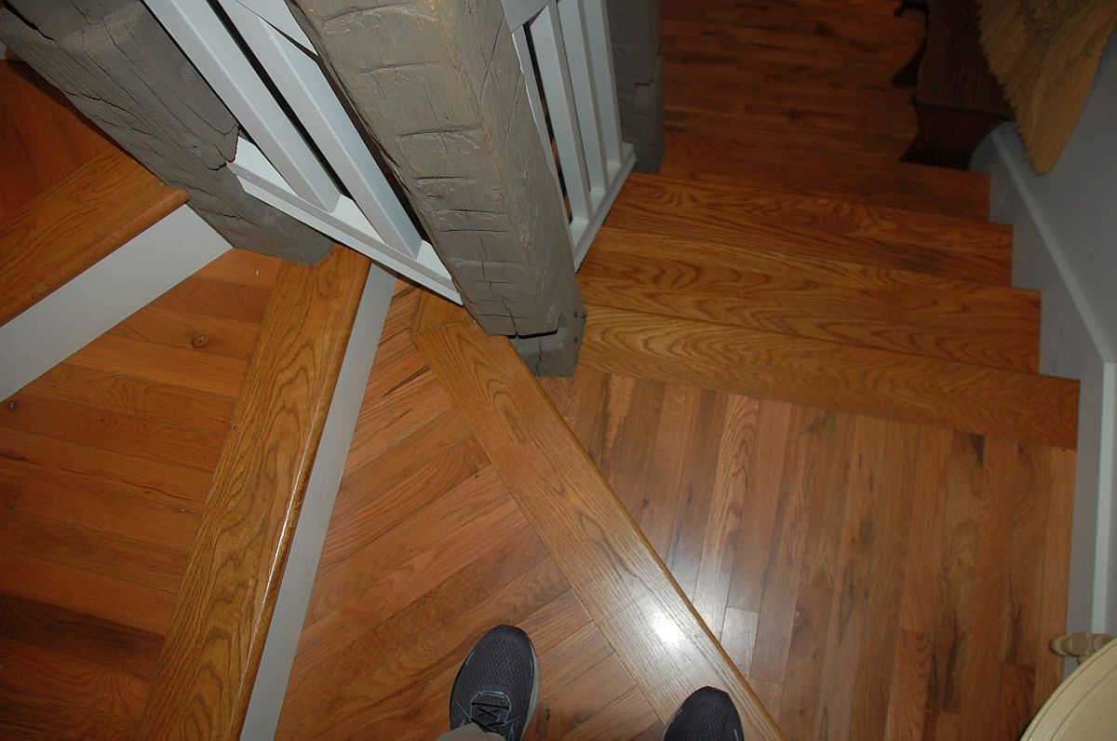
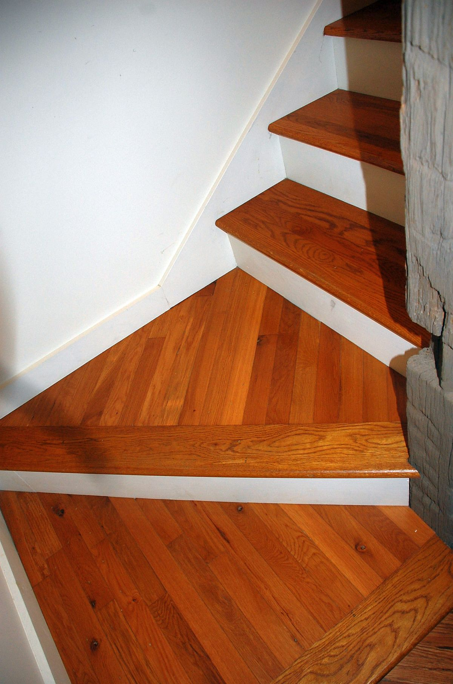
Going down again

Slide 24
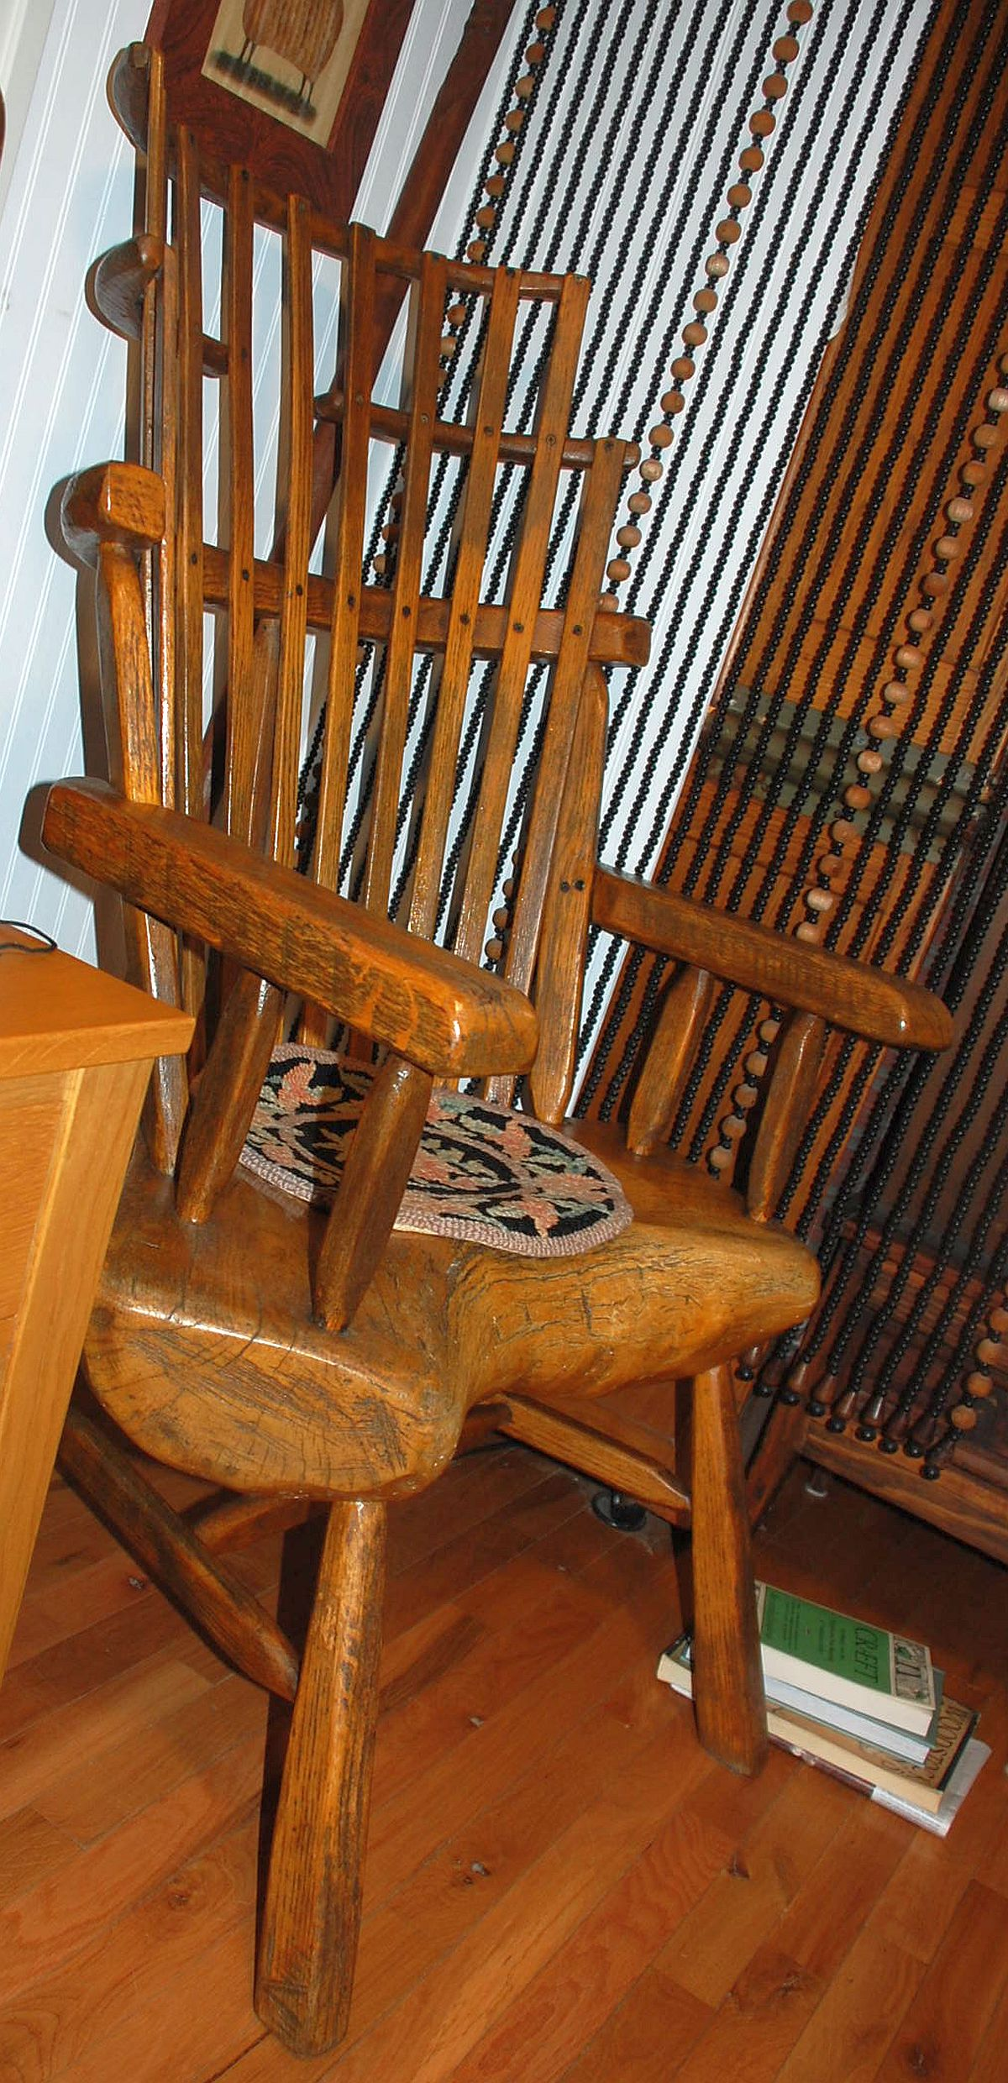
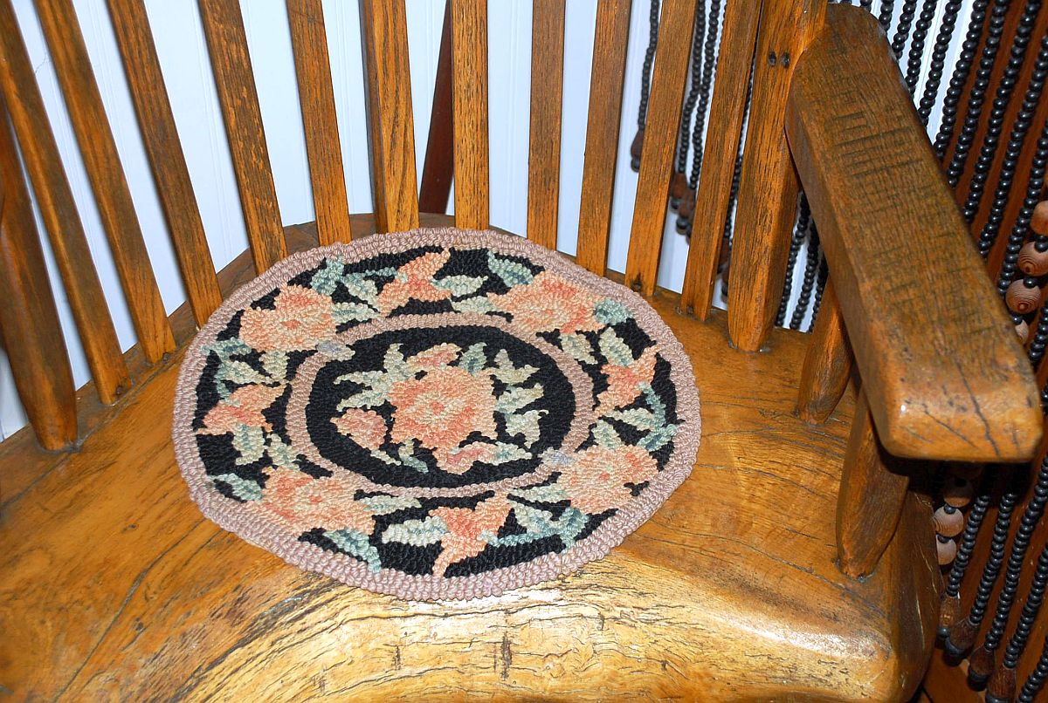
Back at the bottom is Janice’s chair, with a hooked rug mat. She says it was made by some crafts people who make various items of furniture in this style.
The seat is an impressive piece of wood. Janice says that it has been the chair she sits in when she weaves; that you can sit in it for long periods comfortably.
They have not found a way to get it up to the third floor where her looms are located.

Slide 25
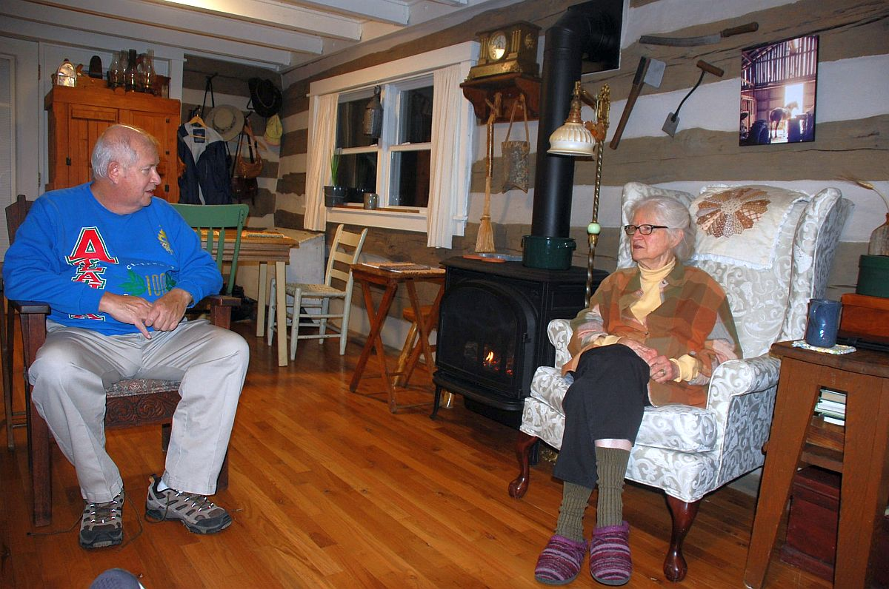
Janice and Colin talk while Hunter is making dinner.

Slide 26

We decided to look at the rug before it got dark.
Hunter and Colin carried it out to a flat area and unrolled it, so that Colin could examine it

Slide 27


Colin examined it closely
He said he thought it had been woven in Iran rather than India because the wefts were blue and because of the character of the end finish.

Slide 28


They social distance when eating. Colin and I are placed at the table.
The two of them sit a little ways off, each with a small table and chair.

Slide 29

A closer look at this table in order to describe what Hunter has fixed.
Top, center is a flavorful salad.
One the lower left is a special variety of coleslaw.
The entre “pie” in the center was a “mince” of chopped pork, corn and apples.
Dessert included a locally produced “pawpaw” ice cream, a fruit flavor I don’t recall having before.

Slide 30
We turned in early. They said they tended to get up about 5 am.
After I was in my bed, I called my wife and experienced the limitations of phone service in their location. I could hear my wife, but she could not hear me.
Janice said that 3G phone service (Hunter has one) is often better than the general 4G service they have.
She said there were also places you could walk to from their cabin, where phone service was better.
I went to sleep thinking that living in beautiful country had some drawbacks one had to be willing to tolerate.

Slide 31
We got up at 5 am and Hunter served us a fine breakfast.
Hardboiled eggs, thick bacon strips and squares of sausage. There was also an interesting granola with fruit. Whole milk was offered and good coffee.
After, we asked Janice if we could see where she wove. She said that required us to climb a steep set of stairs to the third floor.

Slide 32

This is the four-harness loom on which Janice does most of her weaving.
It is the modern version of the type of loom that many homes in the 17th and 18th centuries had and on which they wove textiles the family needed.

Slide 33


Left above: This is a Tape loom, with treadles.
Attributed to the “Pennsylvania Dutch” in early America.
Above: Both spinning wheels are typical of those used in early America (with a modern touch).

Slide 34


Above is a box style loom used for weaving tapes.
Very common.
Above is a reproduction of a loom designed in Berea, Kentucky in the early 1900s.
Hand made in Kentucky cherry with only wooden connections.

Slide 35


Immediate right:
A free-standing frame loom.
Weave by hand with a short shuttle.
Above:
A four-harness table loom.
Harnesses raised by levers on the top.

Slide 36

Drum carder.
Carding is a mechanical process that disentangles, cleans and intermixes fibers to produce a continuous web or sliver suitable for subsequent processing.
An electric version of the drum carder.
Originally, would have been a much larger machine powered by water or horse

Slide 37



Two of the source books on handweaving that Janice uses.

Slide 38



Janice does her own dyeing. And often uses natural ones.
Below: Some of the sources of natural dyes.
Above and immediate left:
Some of the blue shades Janice has produced.
The source of the blue dye is urine-dyed natural indigo.

Slide 39


Below:
Janice handles un-dyed, spun wool from the Leicester sheep she once raised and whose wool she prefers.
Right:
Janice hold a skein of wool she has dyed with black walnut hulls.

Slide 40

We said earlier that one of Hunter’s daily re-enacting practices is chanting.
To properly understand the context of this we need to indicate that Hunter is a skilled, accomplished musician.
Following a career as a Tuba player in the Army Band, a choral director for various churches and denominations, a university voice and music education professor, and sheep shearer for Janice,
Hunter’s special interest is in the performance of 9th c. Gregorian chant, 12th c. Latin chant, and 14th c. French song.
His favorite description of himself comes from a musicologist who wrote about singers: “A singer is likened unto a drunkard, wandering along on a path he does not know.”

Slide 41

Hunter has recorded over 100 pieces of Gregorian chant for Richard Crocker’s Gregorian Archive, in which Crocker attempted to include all the melodies in the ninth-century Carolingian repertory commonly known as Gregorian chant.
On the night of our visit with them, Hunter brought out a few of his musical treasures to show to Colin and me.
There were various medieval manuscripts, performance editions, and hand-copied neumes (medieval notation) from which he sang a few examples of a few of them.

Slide 42




We asked Hunter about his chanting and he got out some of his written materials and explained them and then demonstrated by chanting.

Slide 43

Colin can read music and so could follow more closely than I.

Slide 44
Sheets of music for chants.
Some annotated for performance.

Slide 45


Slide 46

This slide, another Hunter “claim to fame,” is for his having recorded the examples for this book by musicologist at Cornell University, Judith Peraino (early French song).
This past October, Hunter led the St. Basil’s Schola, based in Houston, Texas, on a performing tour of churches in Rome and Paris.

Slide 47


In the morning, after breakfast, we ask Janice if she’d show us some things she’d woven and made.
She said they’d recently been to a re-enactor event, and she had sold some things, but she still had a few.
She took us into a room with things laid out on a bed (far left image).
Going in, I noticed a weaving on the wall (near left).

Slide 48


I asked Janice about this piece, and she said it was not something she had woven but had picked up somewhere.
It interested me because it was a nice, simple but tight, piece of weaving.
More, it was something that a weaver was attracted to and had picked up.
I asked her if it was for sale and, ultimately, I convinced her to take a reasonable price for it (she talked about giving, something I couldn’t accept).

Slide 49

We began to look at the individual pieces.
First, was this striped weaving with attractive
blue and brown stipes.
Janice said that this is a “cabin blanket.”
90” long and 36” wide
Dyed with indigo and black walnut.

Slide 50


On the left is a fringed shawl, dyed in black walnut.
Lower in green are knitted “Musket Mitts,” dyed with copper sulphate.
Next left is a knitted “Monmouth Cap” dyed in black walnut.
Above is a variety of yarns all dyed in natural colors.

Slide 51

Next, was this spectacular “cabin
banket.”
“Hudson Bay Company traditional colors.
Red (madder and cochineal)
Yellow (golden rod)
Blue (indigo)

Slide 52

Near this blanket was a skein of red.
Dyed in madder and cochineal.

Slide 53

Janice said that these skirts were instances of what is properly called “A linsey woolsy Ladies Dress Skirt.”
Very similar.
I was interested in buying one.
I bought the one that looked a little lighter and brighter.
The one on the right here.

Slide 54


This one (closer detail on the right).

Slide 55




Janice gave me some weaving detail on this skirt and skirts of this type.
You have to learn the language.
She also gave me some notes on colors and dyes.

Slide 56

So I took my nice skirt home to DC and hung it where I could look at it every day.
None of the ladies in the family can wear it, and I’ve moved twice in the last two years,…
…but it’s laying near my bed and will go up an appropriate wall soon.

Slide 57



Colin and I started home.
We passed some large round hay bales in the fields.
Some were covered and some were not.
We were told that the hay in uncovered bales fermented and that the covering prevented that.
Animals that chewed a cud, like sheep and cattle, could eat fermented hay, but that it was not advisable to feed fermented hay to horses.

Slide 58


We were driving north on I-81
The Shenandoah valley even at the highway level is beautiful.
I knew an antique dealer in Culpepper who I thought might consider the Henley’s rug.
So, we decided to go home through Culpepper.

Slide 59

Culpepper is an interesting town has an attractive downtown with shops and some good places to eat.

Slide 60


But we first stopped at Sarah’s shop.

Slide 61



We showed Sarah the photos we had taken of the Hensley’s rug.
Colin had never been there, so we looked around.

Slide 62


A week or so later, at the Georgetown flea market, Sarah, (lower right, with green scarf) who sets up there frequently, told me that she had made an offer to the Hensley’s, on the basis of the pictures and Colin’s description, and that they were considering it.

Slide 63
Recently, Janice wrote me:
“I did email Sarah in Culpepper to thank her for the offer for the rug and to say that we would keep it for awhile longer.
“My cousin in Kentucky deals-on a small scale- in Colonial American style antiques and uses the publication, ‘Early American Life’ for display ideas.
“Many of the items are shown are rugs of the type we have, so she has taken the rug to her place. She can provide climate and humidity control at her business but does not have traffic on the rug.
“We will watch to see if the market improves.”

Slide 64
We think our trip to the Hensley’s was a semi-success in terms of its triggering objective.
We did manage to obtain one offer for the rug, and they at least have some idea of what it can command in the current market.
They have an alternative sales channel with which they can patiently wait.
A secondary objective was to see how the Hensleys live, and the array of ren-enacting activities and skills they demonstrated. About this, the visit was an astounding success for Colin and me.
And this documentation if it gave, and gives, us all a chance to live it again.
My thanks to Janice and Hunter and Colin for all the help they gave me.
“Till next time.
John Howe

